Slide 1
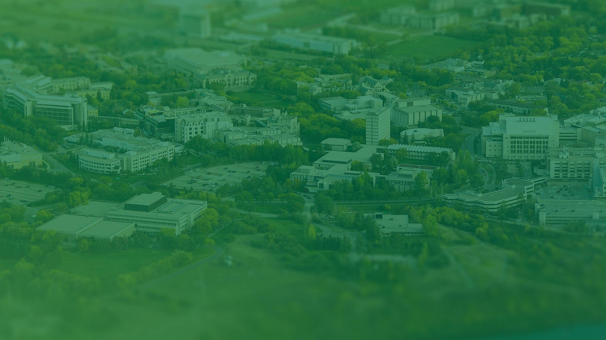


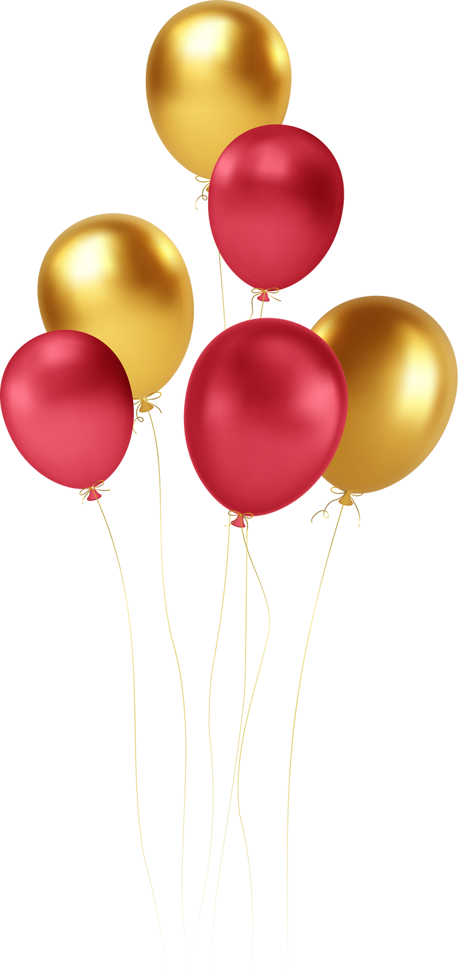



-Year Reunion
1963 Diploma Class
September 14-16, 2023
Notes:
1

Slide 2
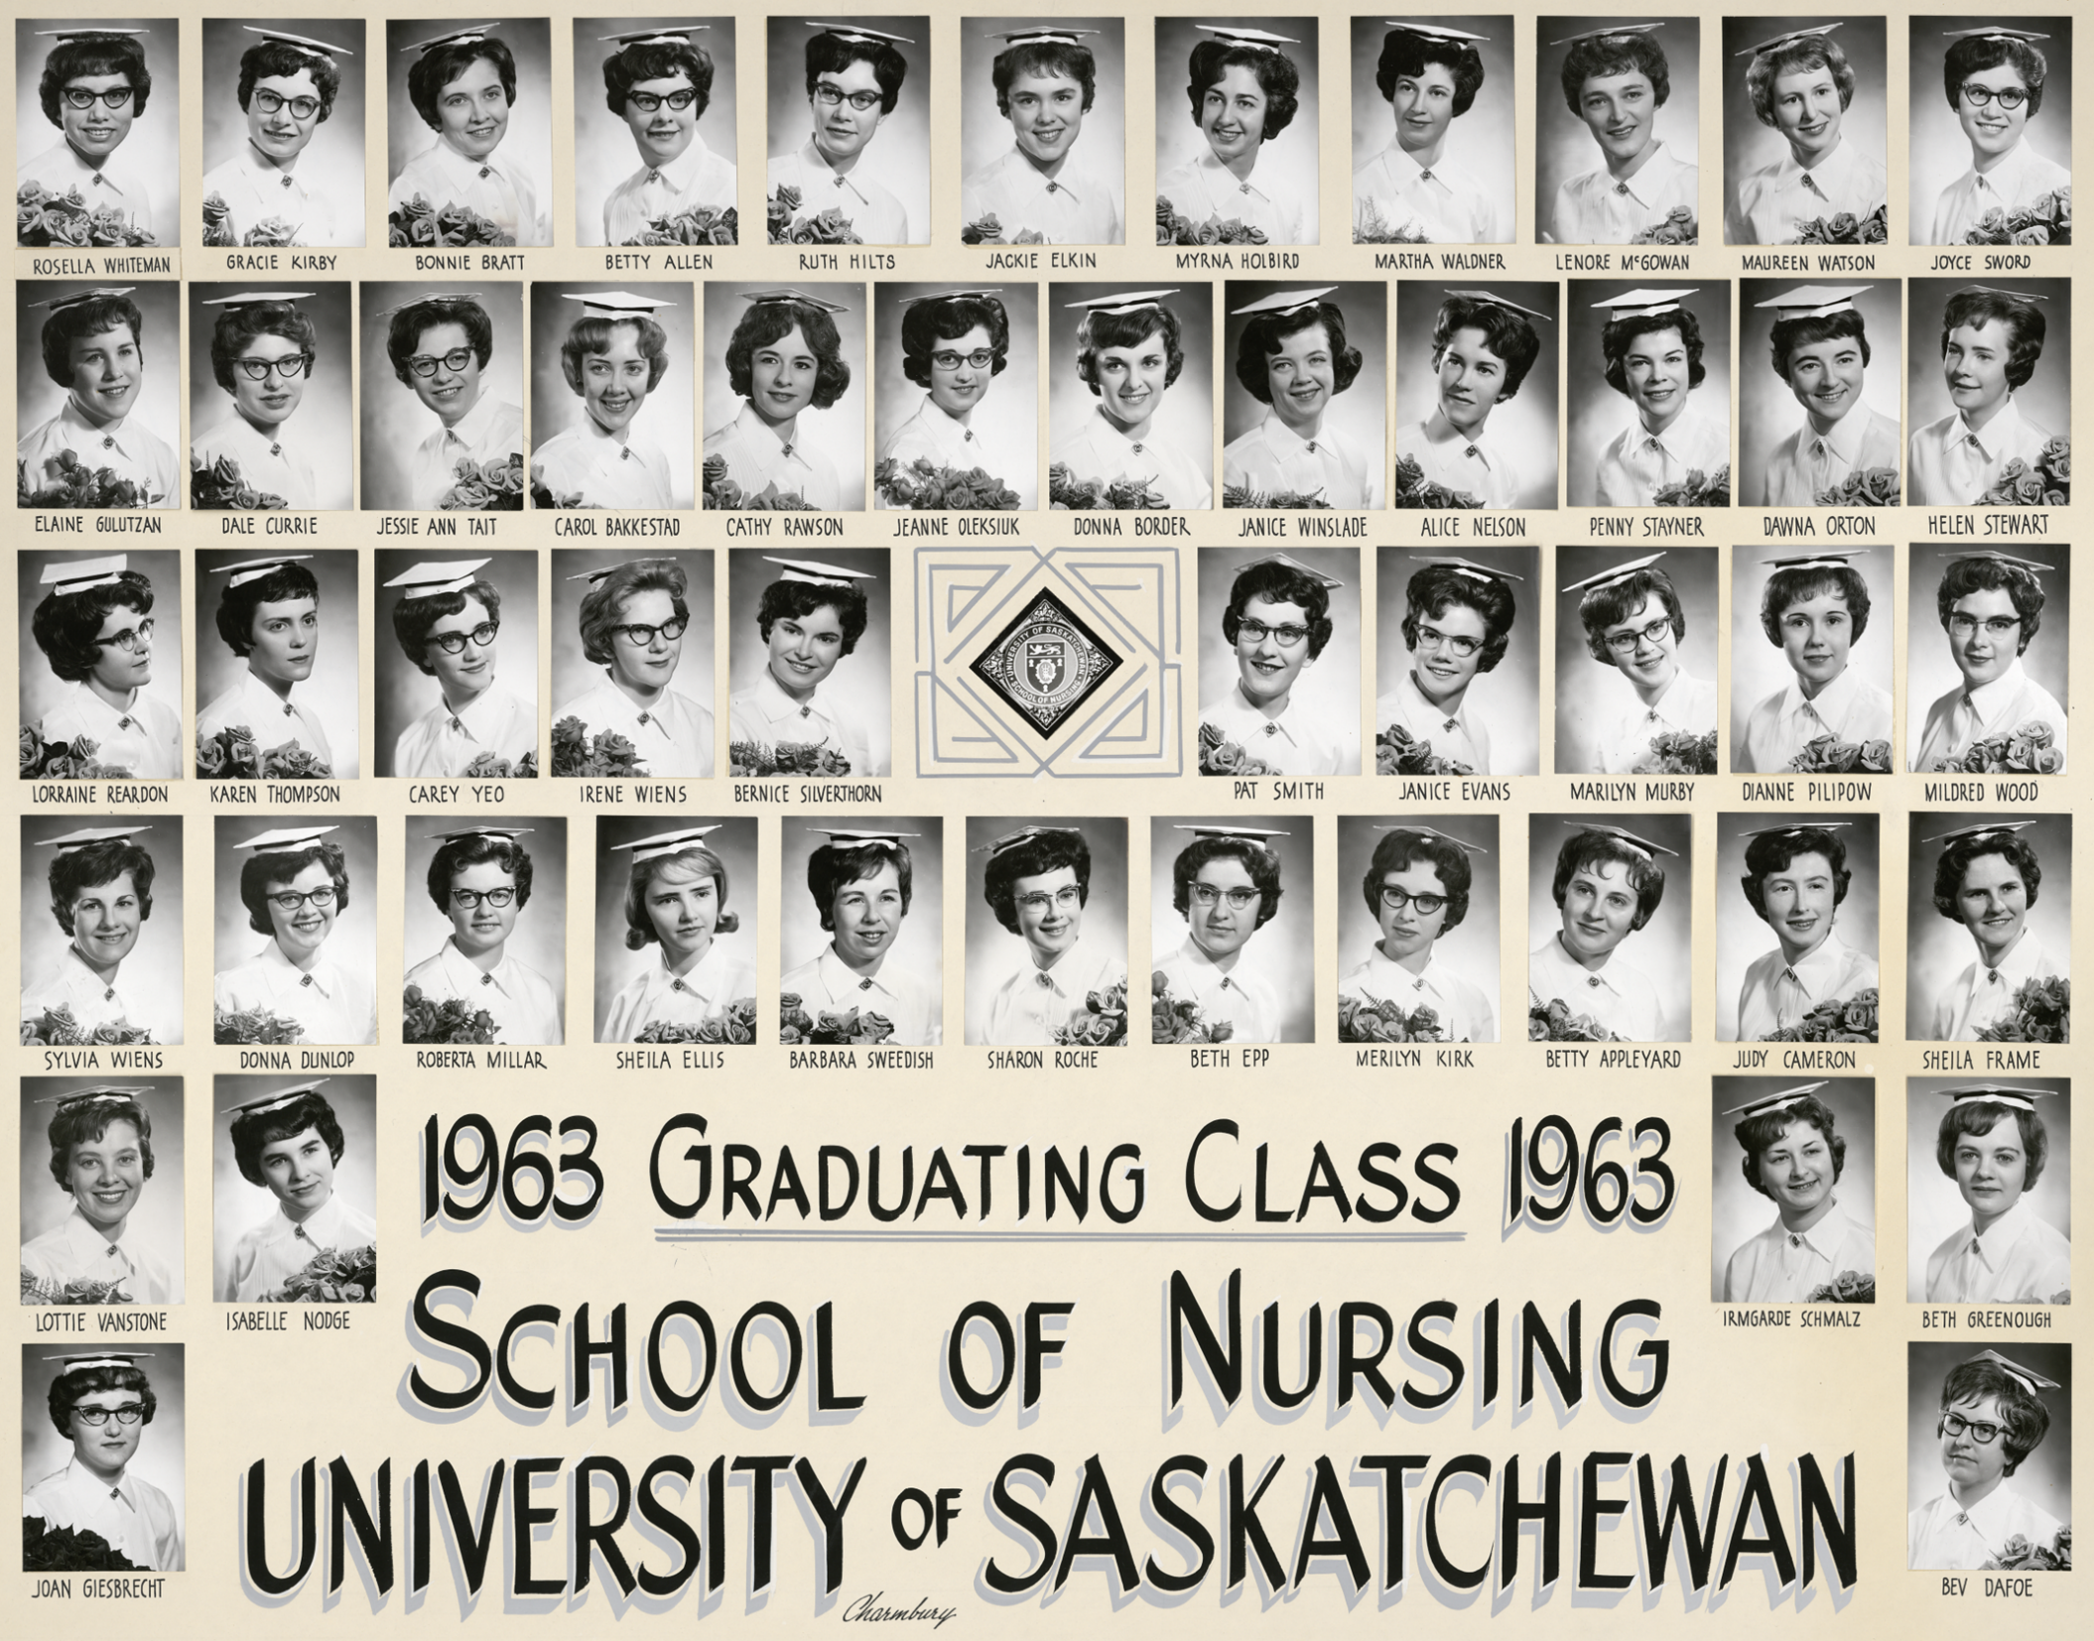

Slide 3
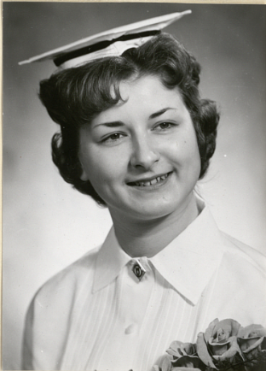
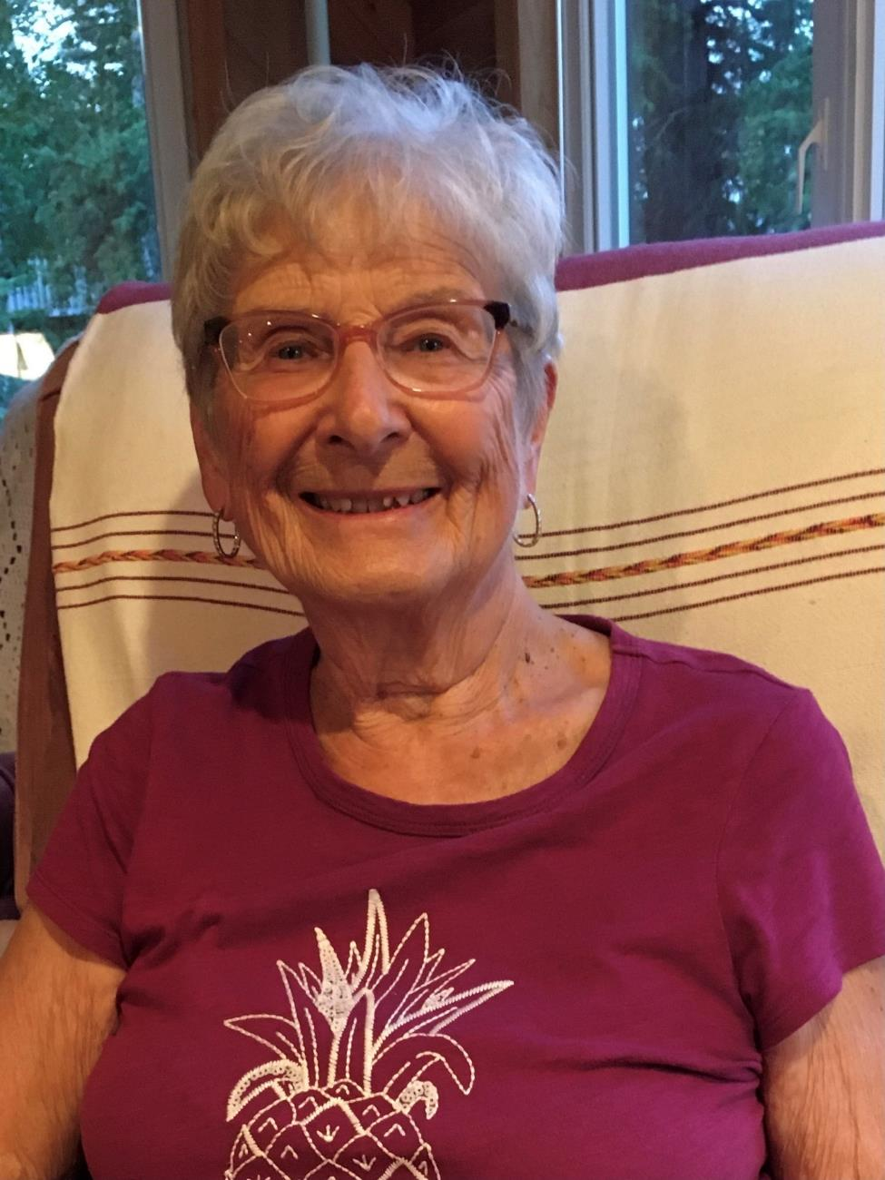
Irmgard (Schmaltz) Carbert

Slide 4
Irmgard (Schmaltz) Carbert
Worked in OR at RUH for 1 year
Travelled to Europe for 4 months with 3 nursing classmates
Worked in Meadow Lake Hospital for 3 years
Married in 1965
We have 2 children;
  Alana lives in Watrous and has 4 children
  Kent lives in Edmonton and has 2 children
Worked in Public Health for 32 years
Retired, moved to lake home in 2000
Enjoyed fishing, travelling, gardening
Moved to Edmonton to an independent, assisted living complex (November 2022)
Adjusting to new home

Slide 5
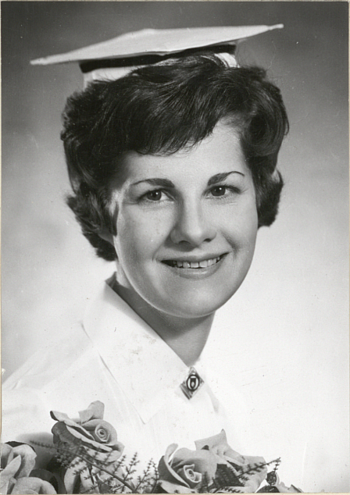
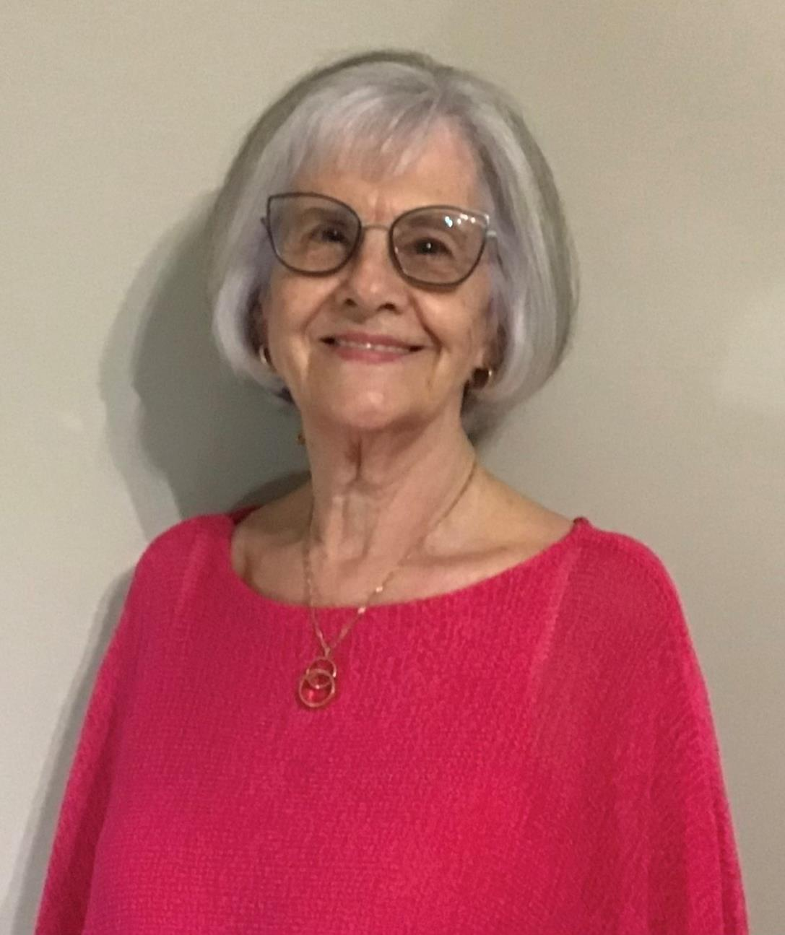
Sylvia (Wiens) Elchuk

Slide 6
Sylvia (Wiens) Elchuk
I was married in 1964 and was widowed in 2013.
We had 2 children;
  Michael (Sonya) who lives in Red Deer.
  Lisa (Eric) who lives in El Paso, Texas. They have 2 children (Judah & Kenya)
We lived in:
  Regina (L&D) /64-65
  Kindersley (L&D, surgery & medicine) /65-70
  Estevan (L&D, surgery, Emergency) /72-88
  Saskatoon (NICU) /88-2011
(OH & S) 2011-13
(RUH-L&D) /63-64
I continue to live in Saskatoon and enjoy socializing, volunteering, and traveling with friends.

Slide 7
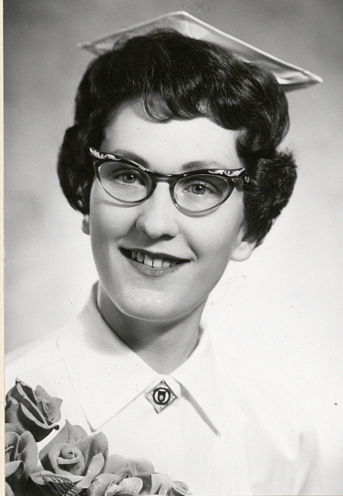
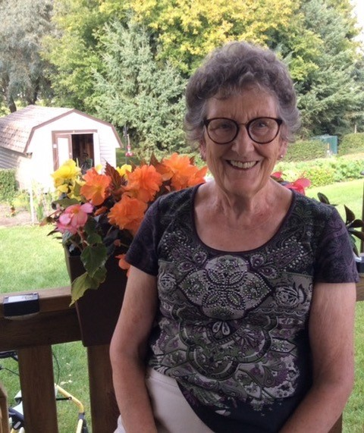
Patricia (Smith) Kachman

Slide 8
Patricia (Smith) Kachman
Main nursing career in Public Health in Canada, India, and Kenya; enjoyed each and every challenge.
In 2000, married a widower, Don Kachman
    We have 14 grands and 18 great grands: 14 boys & 4 girls. Most live in the US with 4 in Canada!!
Moved back to Saskatchewan when I married and lived on a farm for 19 years!
Now living in Canora, SK and life is full with family, church, and community life.

Slide 9
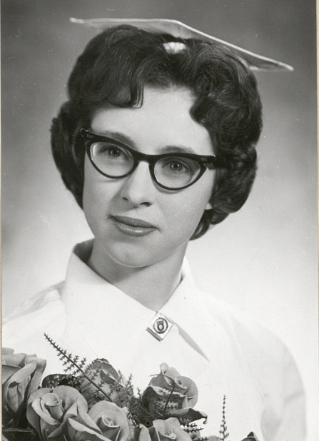
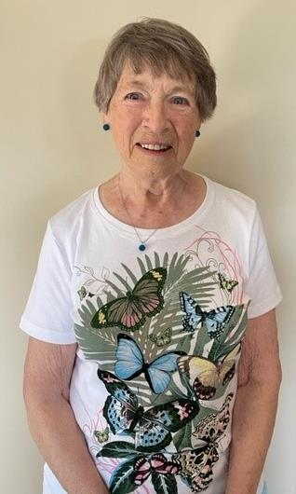
Merilyn (McNaught) Kirk

Slide 10
Merilyn (McNaught) Kirk
Married (61 years to Barry Kirk)
3 sons: Bruce, Vern (Michelle), Stephen (deceased 1989)
1 Granddaughter, 4 grandsons, 1 great-granddaughter
Worked at R.U.H: Obstetrics (all units)
  ENT and Plastic
  For a G.P in Colonsay (28 yrs)
  Nurse on call at school and district (before 1st responders existed)
  Delivered 2 babies in vehicles en route to hospital
  Assisted R.C.M.P in emergencies
  Taught CPR at mines, schools, and surrounding districts for 15 years.
  Ran wellness clinic in Allan (7 yrs)
58-year member of Rebekah Lodge (past president of SK Rebekah Assembly 1989-90)
Loves spending time with family, watching sports, reading, gardening, singing in Church and Rebekah sessions
Lived on family farm for several years.
Moved to Colonsay in 1972 (currently residing here).

Slide 11
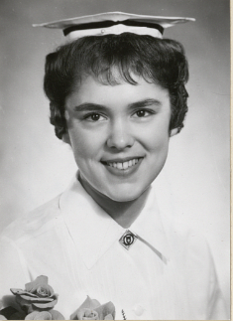
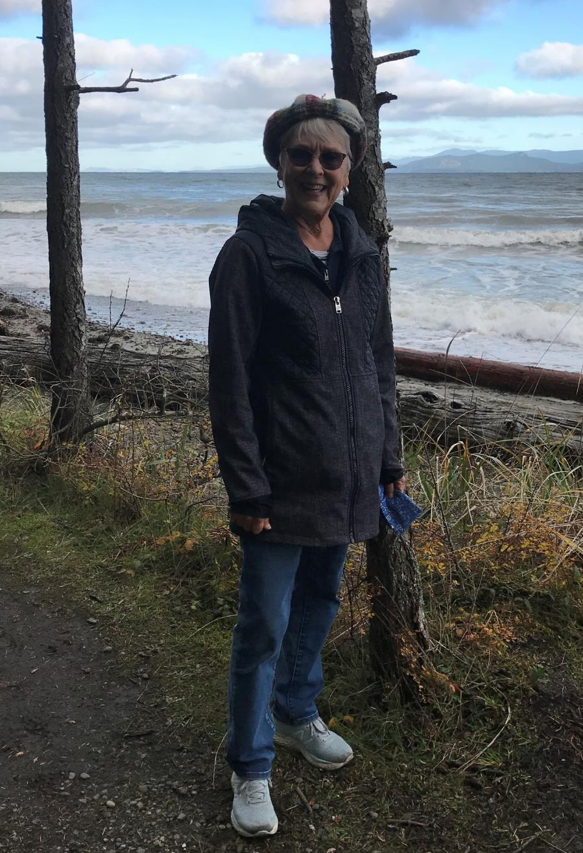
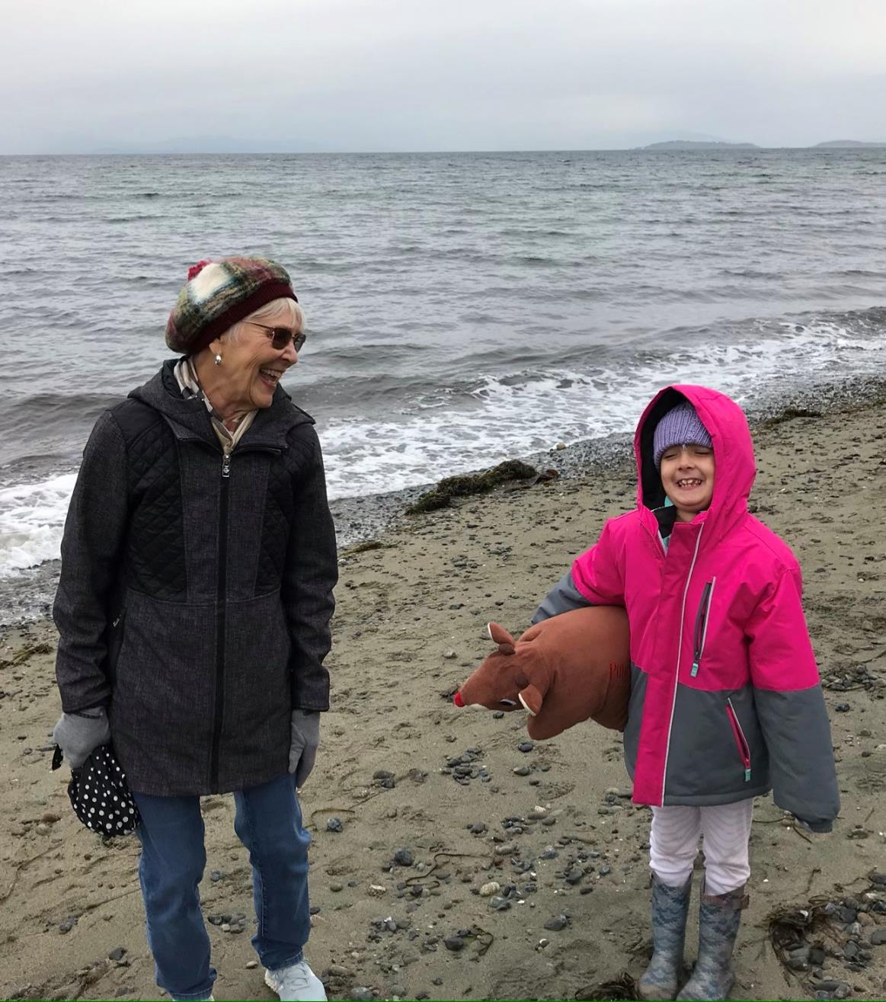
Jackie (Elkin) McKinlay

Slide 12
Jackie (Elkin) McKinlay
Worked in London, ON at the children’s hospital (1963-1964)
Worked on medicine at Swift Current Union Hospital and then the University Hospital in Saskatoon
Worked with V.O.N. In Moose Jaw and also in Calgary
Public Health in Calgary and Strathmore
Parkside Extendicare in Regina
I have 3 grandchildren – two girls (10 and 7) & one boy (3 years old)
I am widowed
I now live in Parksville, BC
I have enjoyed clogging and Pickleball and now do square dancing, line dancing, and round dancing.
Love to walk and hike and have also done some traveling.

Slide 13
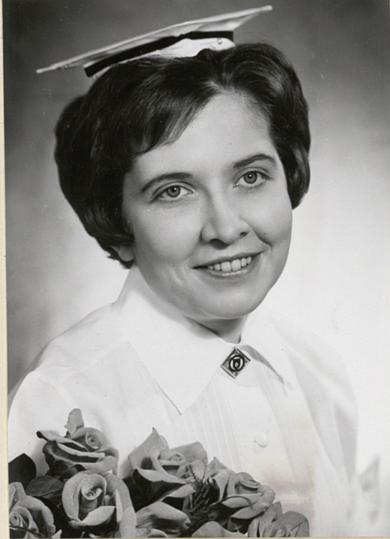
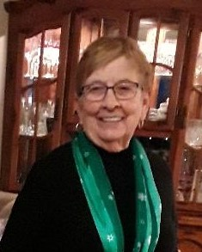
Bonnie (Bratt) McMillian

Slide 14
Bonnie (Bratt) McMillan
My career focused on home care and public health nursing in SK and AB.
My career culminated as the Director of the Drumheller Health Unit.
Retired for 28 years.
2 sons & 4 grandchildren
Married to Ken for 55 years.
We live in Penticton, BC
We enjoy Jr. A hockey, golf, camping, and many other events such as Peach Festival, Elvis weekend, and music productions. We also like walks by our 2 lakes, Okanagan and Skaha.
For the past 22 years, we relaxed 3 winter months in Melaque, Mexico.

Slide 15
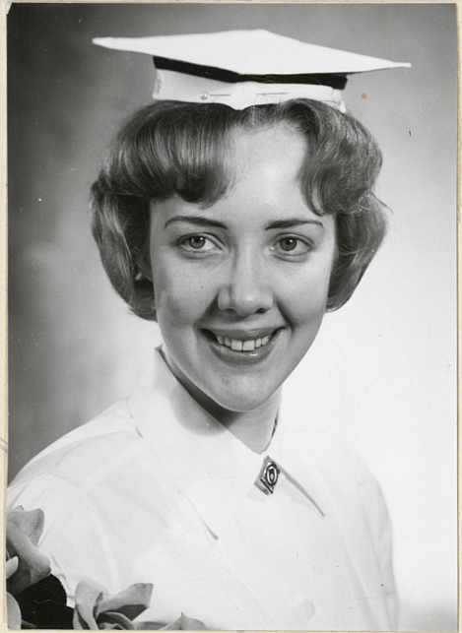
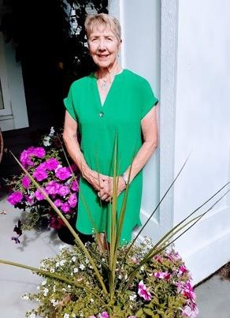
Carol (Bakkestad) Mitchell

Slide 16
Carol (Bakkestad) Mitchell
Worked primarily in Acute Health Care in institutions and community and in Secondary Education in Health Care Professional’s Faculties. My role was as a direct health care provider, educator, project manager and executive. The places I worked were acute care in rural Saskatchewan, acute care, long term care and community health care in Manitoba, educator and acute care in Brisbane Queensland and Project Manager in Perth at the University of Western Australia, in British Columbia have worked as a direct care provider, educator, director, researcher, project manager in acute care hospitals, long term care, in Universities and consulted with the Provincial BC Health Department. My career focus has been with Elder, Children and Women’s Family centered Health Care.
2 adult sons & 4 grandchildren.
Married for 59 years to Bob Mitchell, graduate of UofS, Agriculture,1962 .
We live in Delta BC.
I enjoy traveling, golfing, curling, horseback riding, hiking, bridge, cribbage, scrabble, and painting.
I belong to the local Canadian Federation of University Women group & volunteer at the Kwantlen Polytech University in Surrey to help develop educational short courses for seniors and others; we socialize with a group of friends called the Fun Lovers and go camping, play golf and hike...etc.

Slide 17
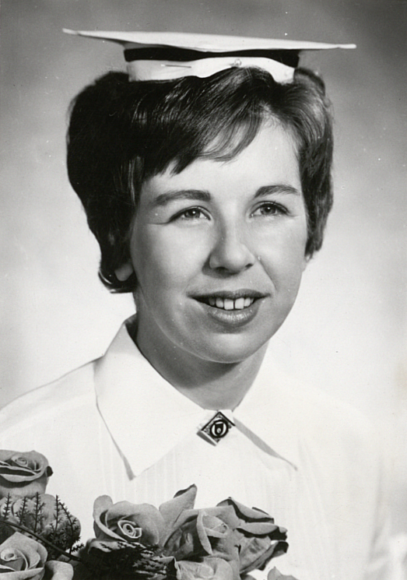
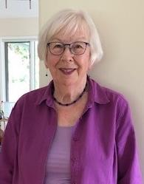
Barb (Sweedish) Morrall

Slide 18
Barb (Sweedish) Morrall
Married to Robin in 1964
Widowed in 2018
We had 2 children;
  Rani (died after a long illness in 1999)
  John (Kim) – they have 4 children
We lived in Saskatoon (except for 2 years in France)
Completed BSW in 1985
Worked:
  Part-time at RUH and Student Health
  Social Worker at Saskatoon Cancer Centre until 1992
  YWCA Child Care Centre until 2001
  Volunteered in schools as a tutor for 19 years
I enjoy walking, aquafit, music, book club, spending time with friends, grandchildren, their parents, and other relatives

Slide 19
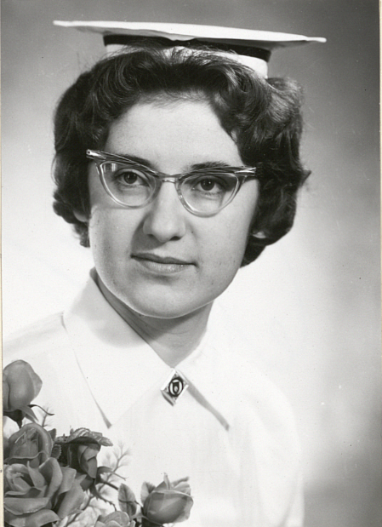
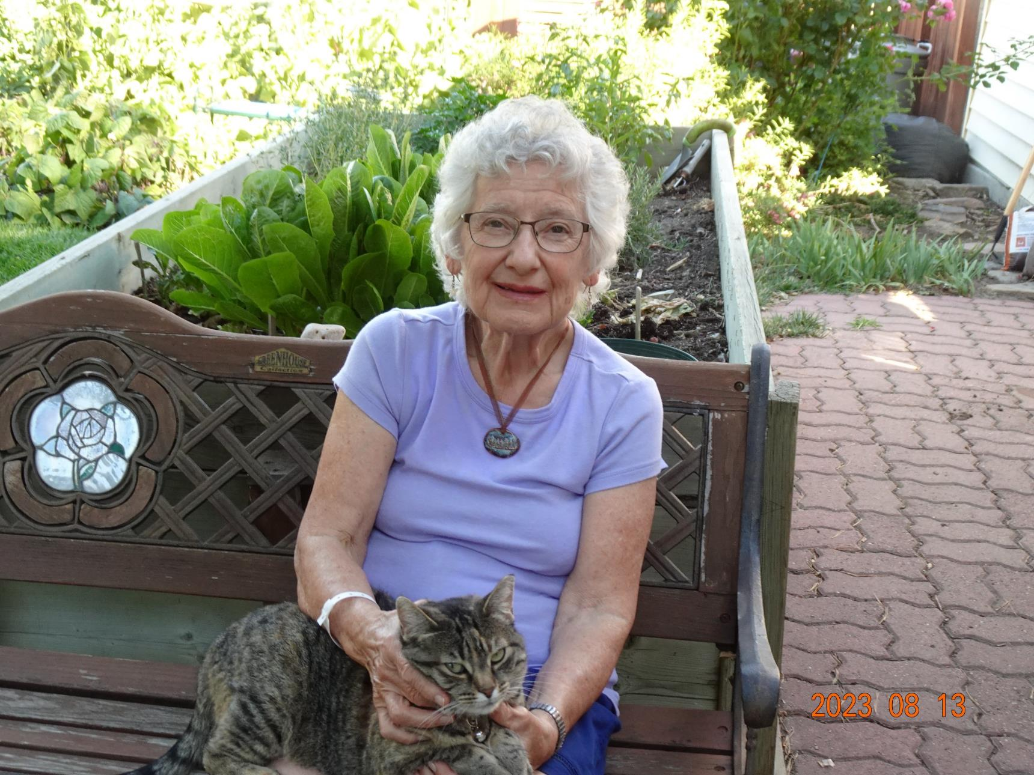
Elsbeth (Epp) Moyer (Beth)

Slide 20
Elsbeth (Epp) Moyer (Beth)
Married to Jim Moyer (49 years)
Lived in Lethbridge, AB (since Nov 1977)
Two daughters;
  Marie – married with two married stepsons; works with L’Arche
  Joanne – Prof – The King’s University, Edmonton
Hospital work: Saskatoon, Montreal and Newfoundland
BScN in P. H. U of S, ‘72
Public Health in Biggar, SK; Lethbridge; VON, Brandon, MB
Travel: 5 continents; all provinces/territories in Canada
Enjoy travelling, gardening, volunteering, and choir

Slide 21
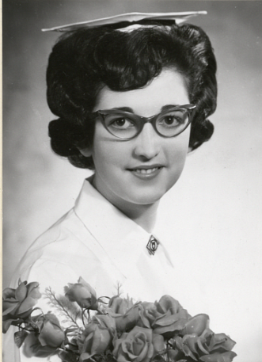
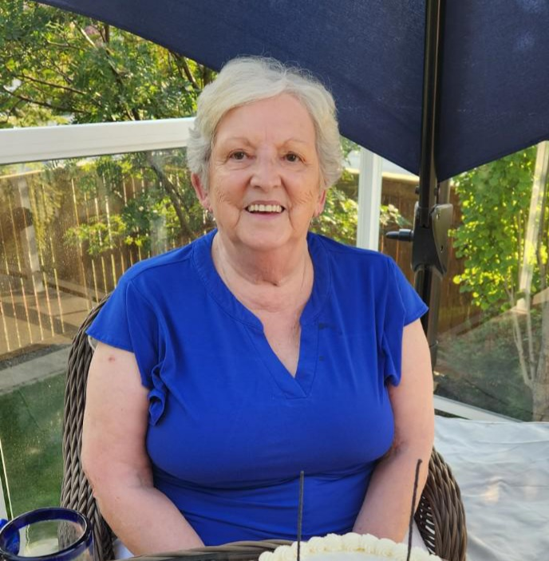
Eugenia (Oleksiuk) Richardson

Slide 22
Eugenia (Oleksiuk) Richardson
Married to Allan in 1966
Lived in Medicine Hat, AB (until 2000)
Had 3 children & blessed with 4 grandchildren
  Very involved with the Ukrainian dancers, Beta Sigma Phi, and children’s activities
Worked in the hospital as NUM in ICU
Obtained my BSN through the University of Lethbridge
In 2000, we moved to Calgary (worked in ophthalmology, several years in Alternate Medicine, and my last 10 years of nursing in the Canadian Blood Services)
My husband, Allan, of almost 50 years, died of lung cancer in 2016
Christa, my youngest, died of esophageal cancer in 2018
For over 40 years, I taught Ukrainian egg decorating mainly to grade 2 & 3’s in schools, traveling over parts of Alberta
I am still doing them for relaxation and craft sales, and of course, with permission from the NHL, doing eggs with hockey logos with proceeds going to charity
My dream is when I am mobile again, to visit Saskatchewan (my hometown and area), but especially USask

Slide 23
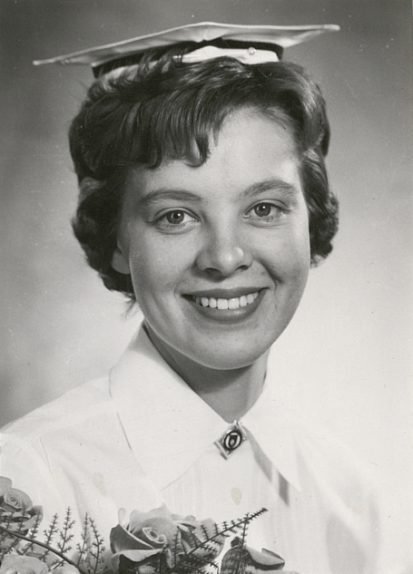
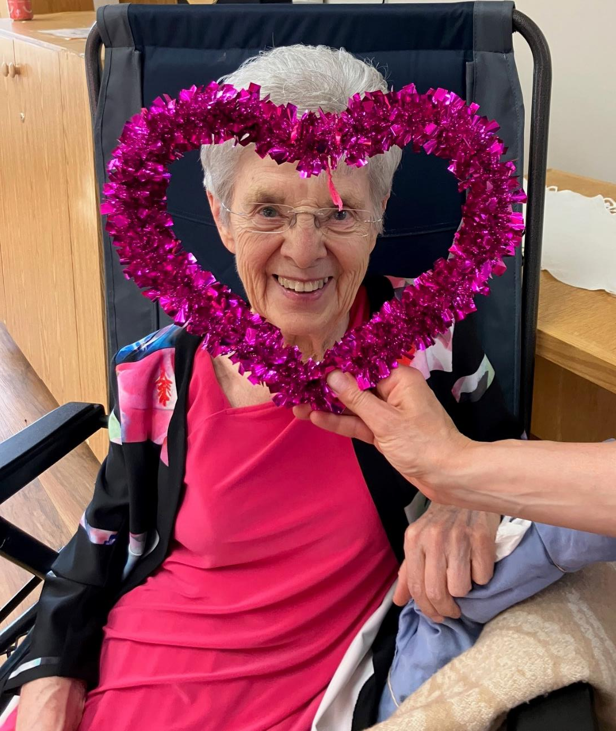
Lottie (Lessing) Vanstone

Slide 24
Lottie (Lessing) Vanstone
I have worked in a few different places including Yorkton on the Psychiatric Ward, but my favourite job was supporting patients in their houses and travelling around in a beetle with the Victoria Order of Nurses in Saskatoon.
I have three children;
  Mark Vanstone (Vanesa)
  Lana Janzen (Grady)
  Joy Vanstone (Luke McConnell)
  Mark has three wonderful children – Jonah, Micah and Brenna Vanstone. They are in their twenties and don’t have children yet… but I’m looking forward to it.
Wes and I just celebrated our 61st wedding anniversary in June 2023!
This year, I was blessed to be able to move into Circle Drive Special Care Home with my husband, Wes.
My favourite thing is singing…and my kids will tell you I seem to remember a wide variety of songs!!!

Slide 25
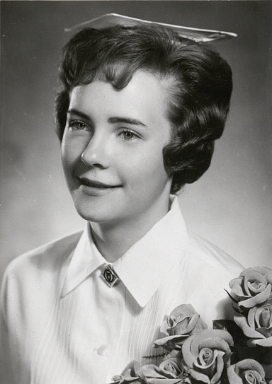
Helen (Stewart) Verokosky

Slide 26
Helen (Stewart) Verokosky
I worked at the University Hospital in Saskatoon, Medicine Hat Hospital, and then Kelowna General Hospital for 33 years after we moved to Kelowna in 1969.
My husband and I have 2 sons and 3 grandsons.
My hobby is gardening.

Slide 27
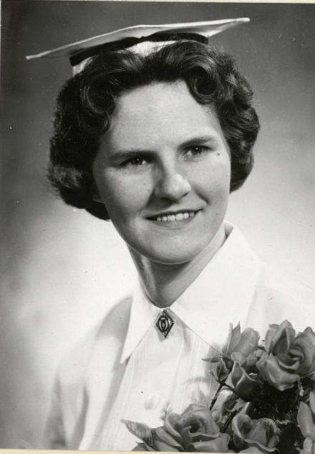
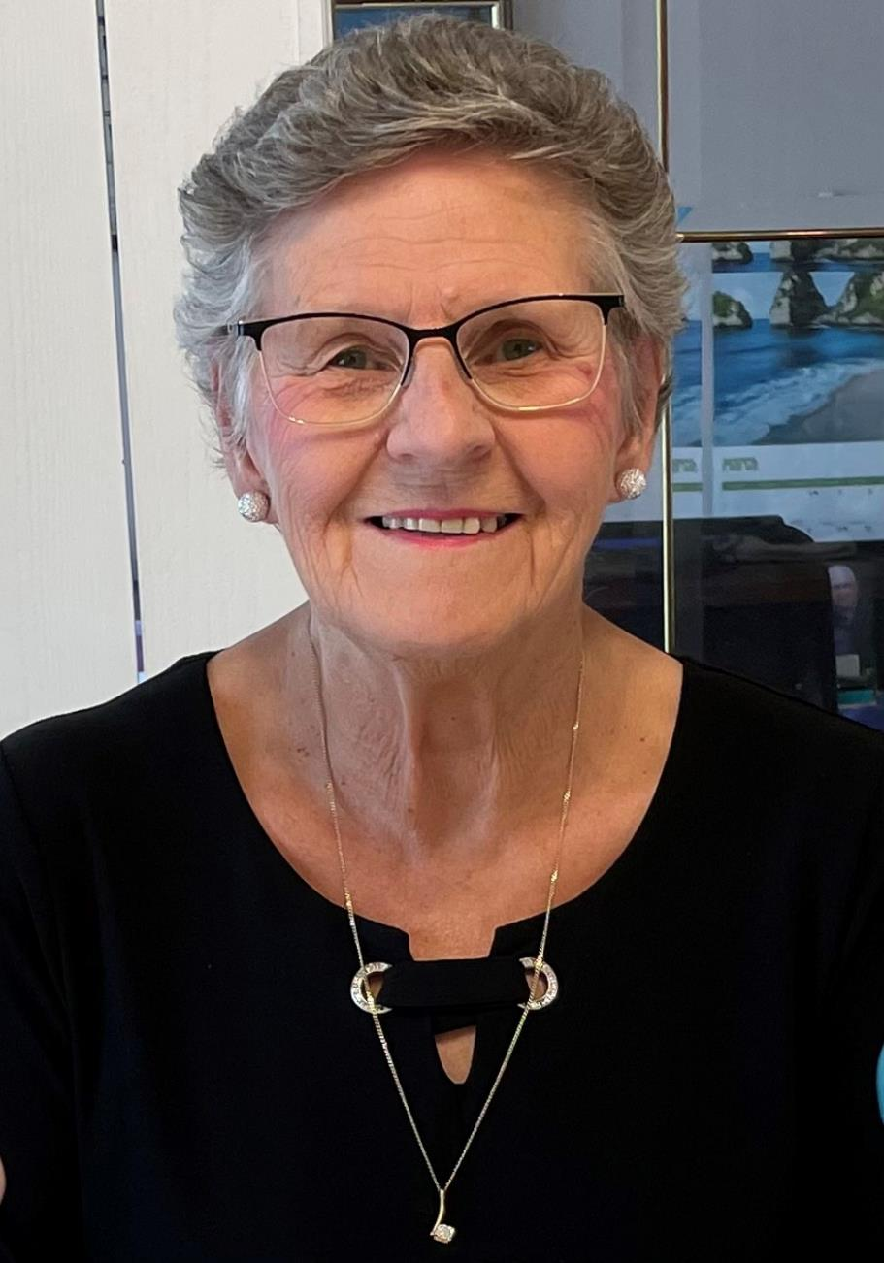
Sheila (Frame) Wilson

Slide 28
Sheila (Frame) Wilson
Work:
  School nurse in Nigeria
  Parkland Nursing Home, Melfort
  Coordinator, Adult Day Program, Sherbrooke Community Centre
  Manager, WestPark Lodge Assisted Living, Red Deer, AB
Married to Bob (60 years in Oct/23)
2 children (Ian and Jennifer)
4 grandchildren (Mitchell, Sheena, Dale, Regan)
Living in Regina
Enjoy church activities, traveling, camping, reading, watching curling, and attending Rider games

Slide 29
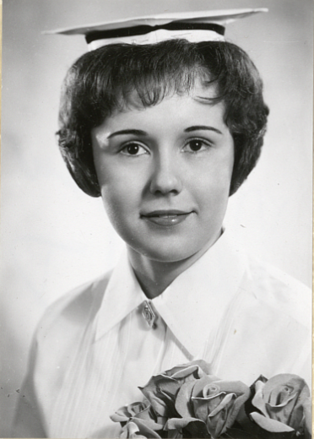
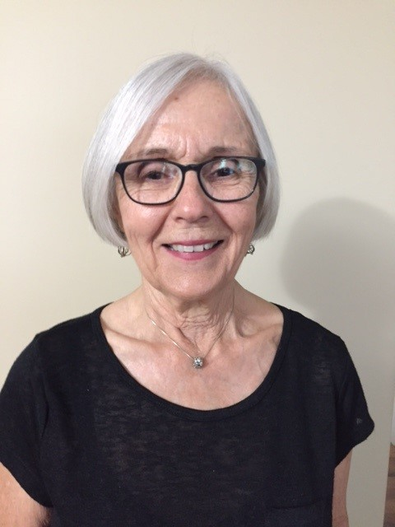
Dianne (Pilipow) Yadlowski

Slide 30
Dianne (Pilipow) Yadlowski
Married in 1965.
We have a son in Regina, and a daughter in Cochrane, AB.
5 grandchildren, 2 oldest at university now.
Summers spent at our cabin at Emma Lake and golfing.
Winters curling and cross-country skiing.
Worked at RUH, head nurse, relief evening supervisor, and general duty in the MRI.
Retired in 2003.
Travel extensively with extended winter vacations in Arizona, Mexico, and Hawaii.
We still reside in Saskatoon.

