Slide 1



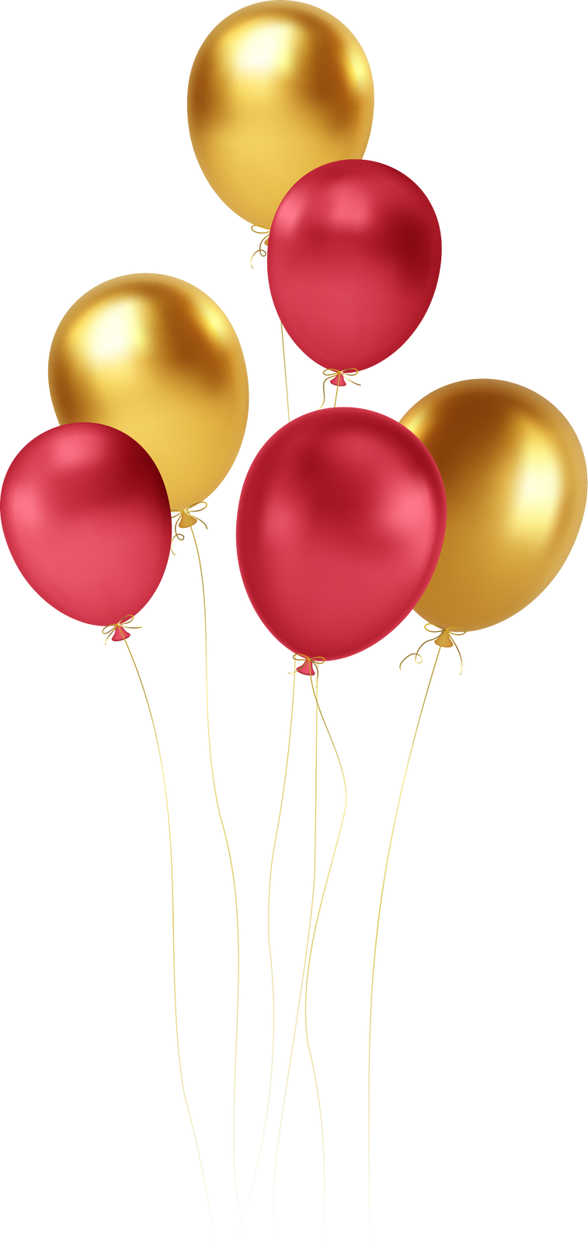


30-Year Reunion
1994 Degree Class
June 7-9, 2024
Notes:
1

Slide 2
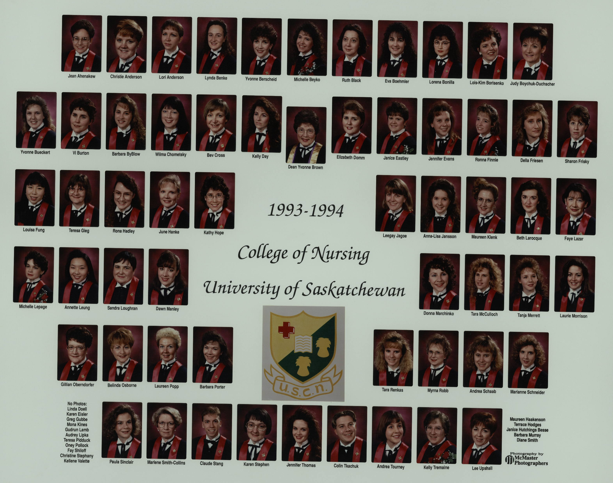

Slide 3
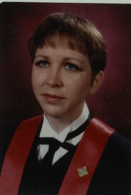
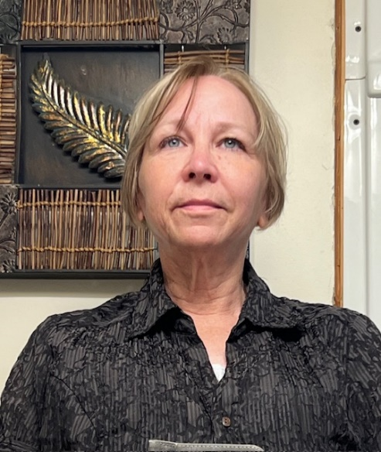
Lori Anderson (Dahlman)

Slide 4
Lori Anderson (Dahlman)
Lives in Assiniboia, SK.
1994-95 – Casual RN at Plains Health Centre.
1995-2007 – Casual in South Central (LTC & some acute care).
2005-2007 – Public Health Nurse ¾ time & casual in Bengough & Assiniboia.
2007-2022 – Public Health Nurse in Moose Jaw (until 2011) then Assiniboia.
2022 – Retired from nursing, started work with Labor Relations & Workplace Safety, in P.A. in 2021 and worked as an Occupational Health Officer until 2023.
April-August 2023 – LTC in Assiniboia & Lafleche.
August 2023 – Senior Program Consultant with Ministry of Health - LTC, Home Care & Palliative Care.
Married in 1992 to Harley (separated 2011, divorced 2022).
3 children: Brett (1992), Noah (1996) & Alyssa (2000).
4 granddaughters.

Slide 5
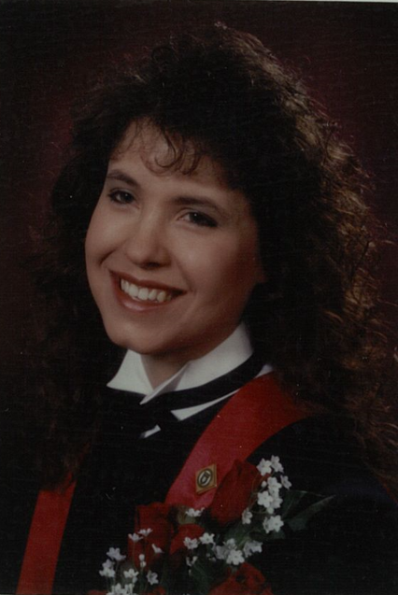
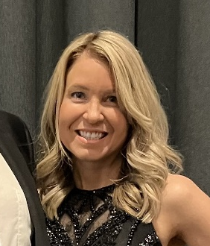
Michelle Beyko

Slide 6
Michelle Beyko
Lives in Saskatoon, SK.
Works for Correctional Service Canada in Saskatoon (30 years).
Currently the National Infection Prevention & Control Specialist.
Celebrating our 20th wedding anniversary this year.
Our 2 sons are married and we are blessed with 3 granddaughters (all under age 3!).
Leisure time is spent in Europe, enjoying time with friends and family, and staying active.
Hoping to retire from the federal government next year!

Slide 7
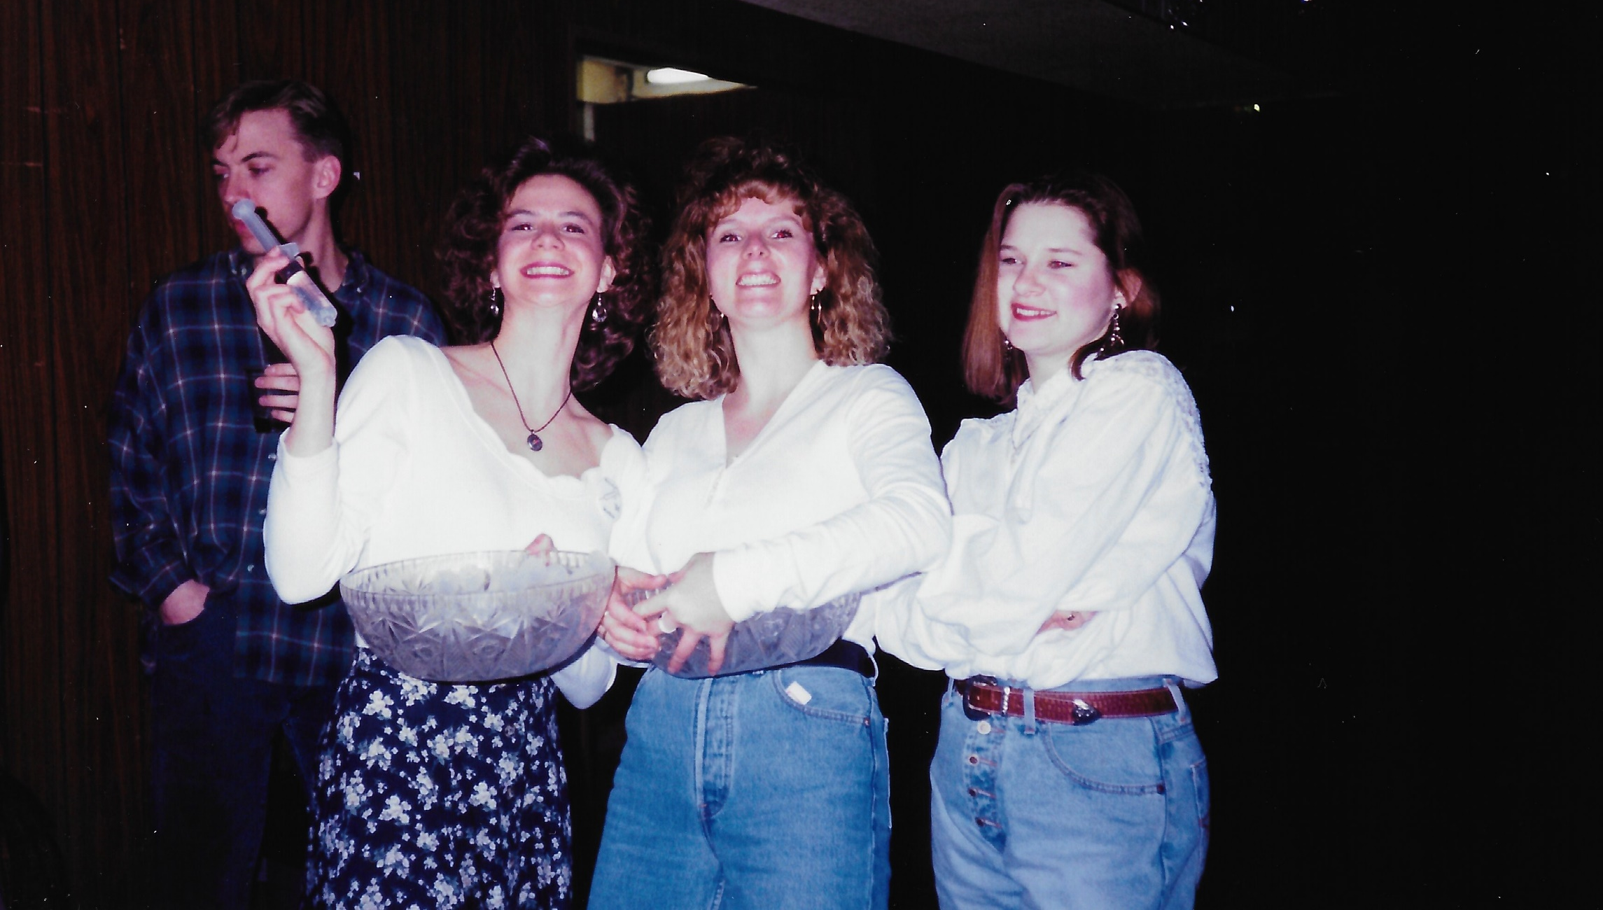
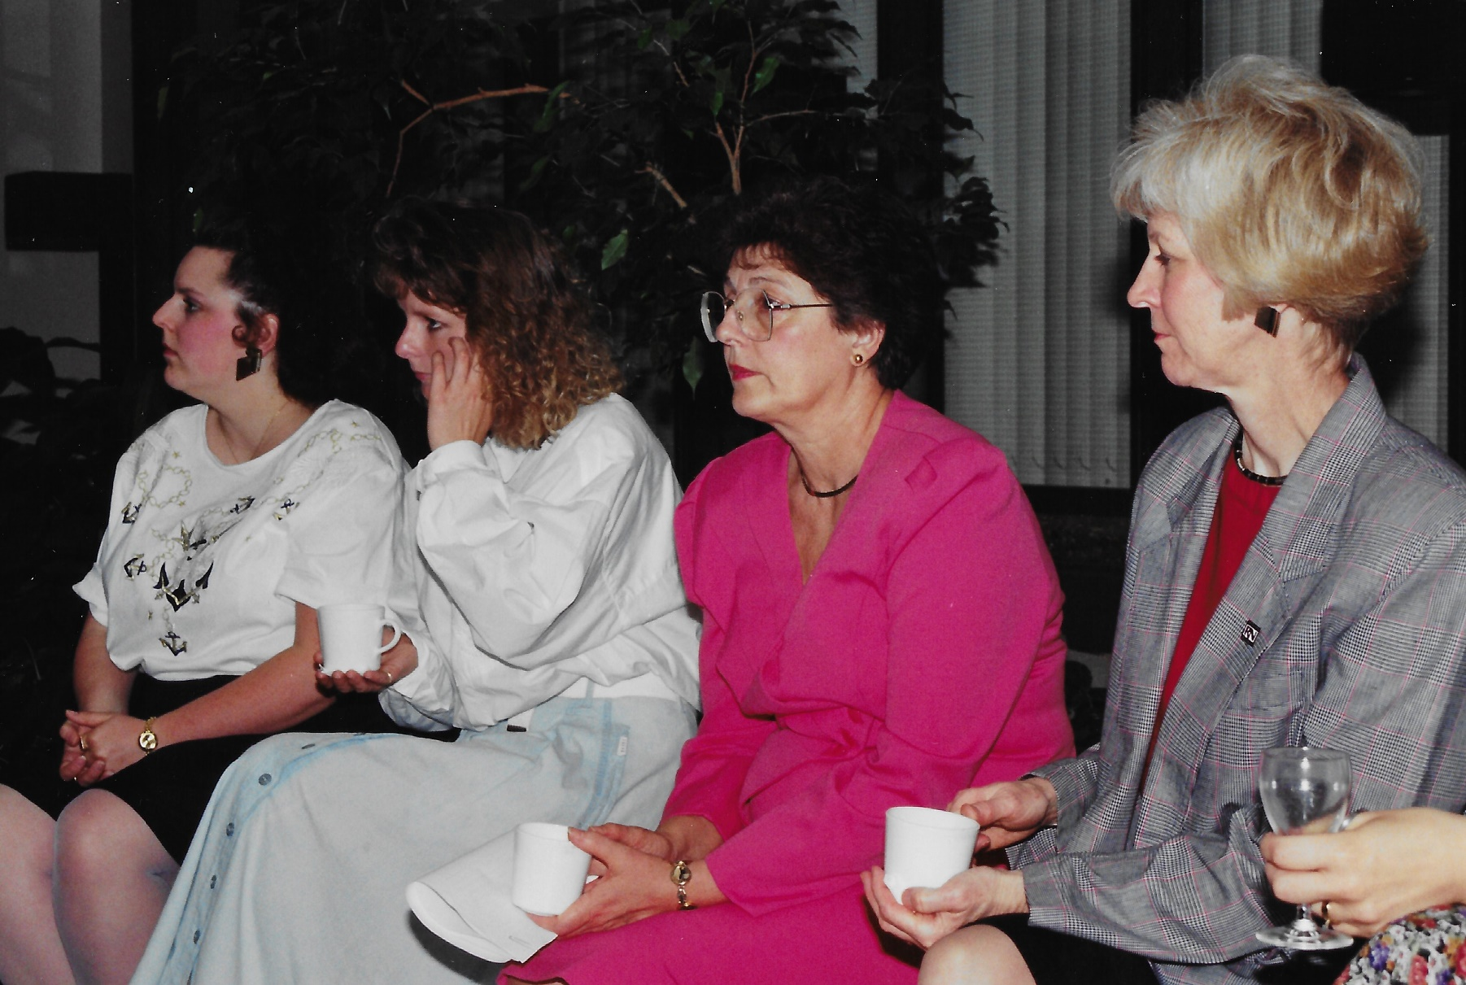
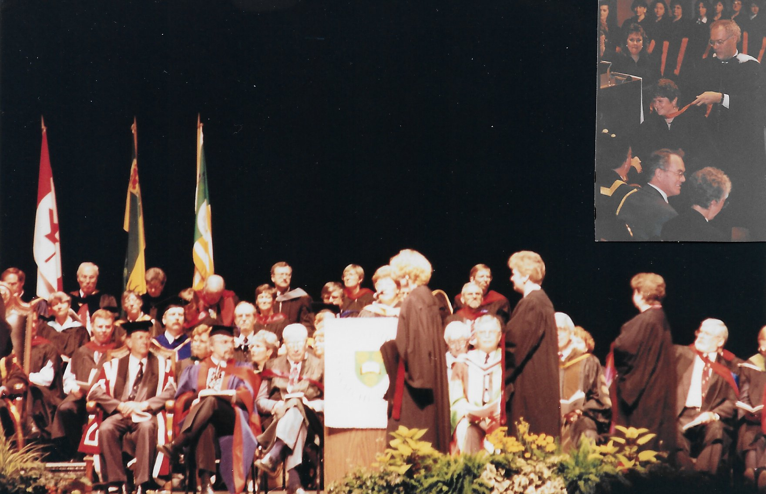
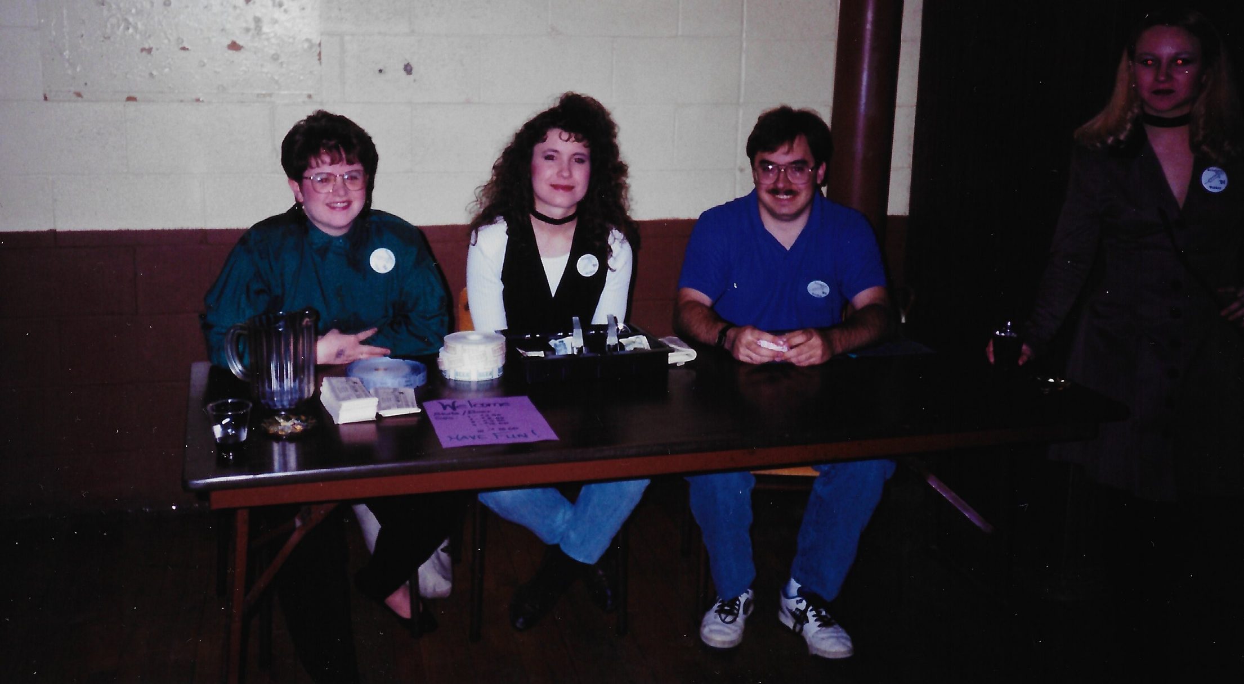

Slide 8
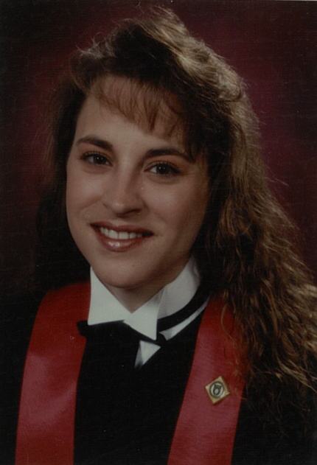
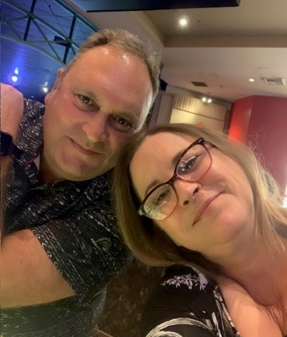
Barbara Asmundson (ByBlow)

Slide 9
Barbara Asmundson (ByBlow)
Lives in Saskatoon, SK.
St. Paul’s Hospital ICU for 15 years, 24 years in total
Will retire from St. Paul’s Hospital someday.
Rotator cuff surgery (off for 6 months).
Todd and I will celebrate our 30th wedding anniversary in November.
Going on Danube River Cruise to celebrate anniversary.
Brooke currently a substitute teacher just outside Saskatoon.
Zane at USask Kinesiology and with Hailey, combined Xray lab tech.
USask memory: Too much time at Place Riel drinking coffee and playing cards.

Slide 10
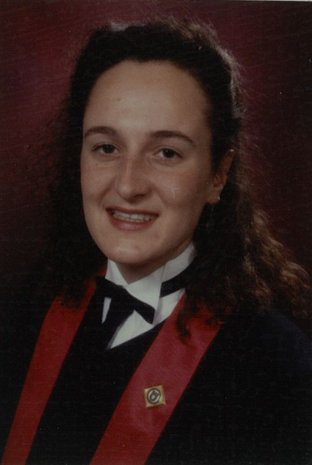
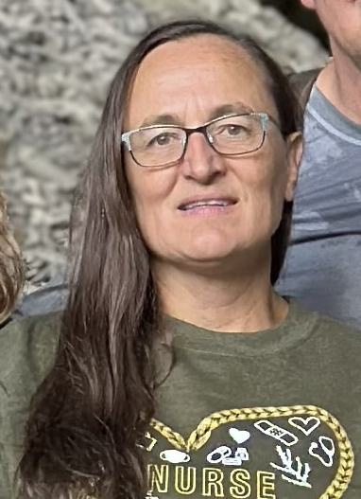
Lynda (Benke) Letkeman

Slide 11
Lynda (Benke) Letkeman
Lives ½ hour west of Meadow Lake, SK on an acreage.
Anya (21 years), University of Lethbridge, 4th year of Neuroscience.
Freja (17 years), graduating from Grade 12.
Gabriela (13 years).
Works full time as a community health nurse at Flying Dust First Nation.
We love getting out into nature, hiking, biking, canoeing, camping & gardening.

Slide 12
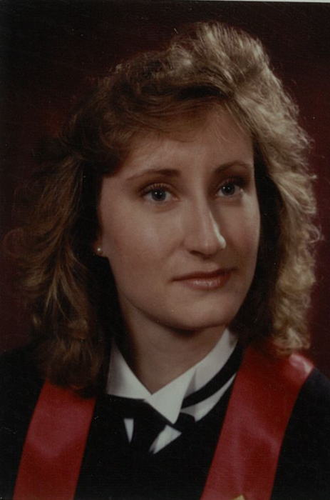
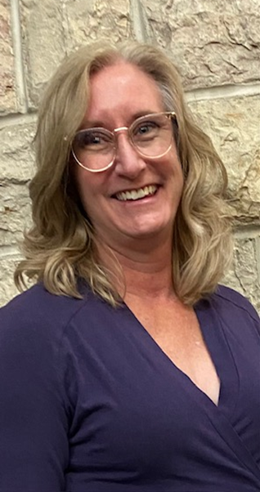
Della Friesen

Slide 13
Della Friesen
Lives in Regina, SK.
Works for Population and Public Health (23 years).
Mason graduated – USask in Mechanical Engineering in 2022.
Abbey will graduate in 2025, Pharm D at USask.
USask memories:
Being young without responsibility!!
So many happy events and memories.
But I have to say that our small class was great!
We obtained our degree among friends, on a beautiful campus that felt like home.

Slide 14
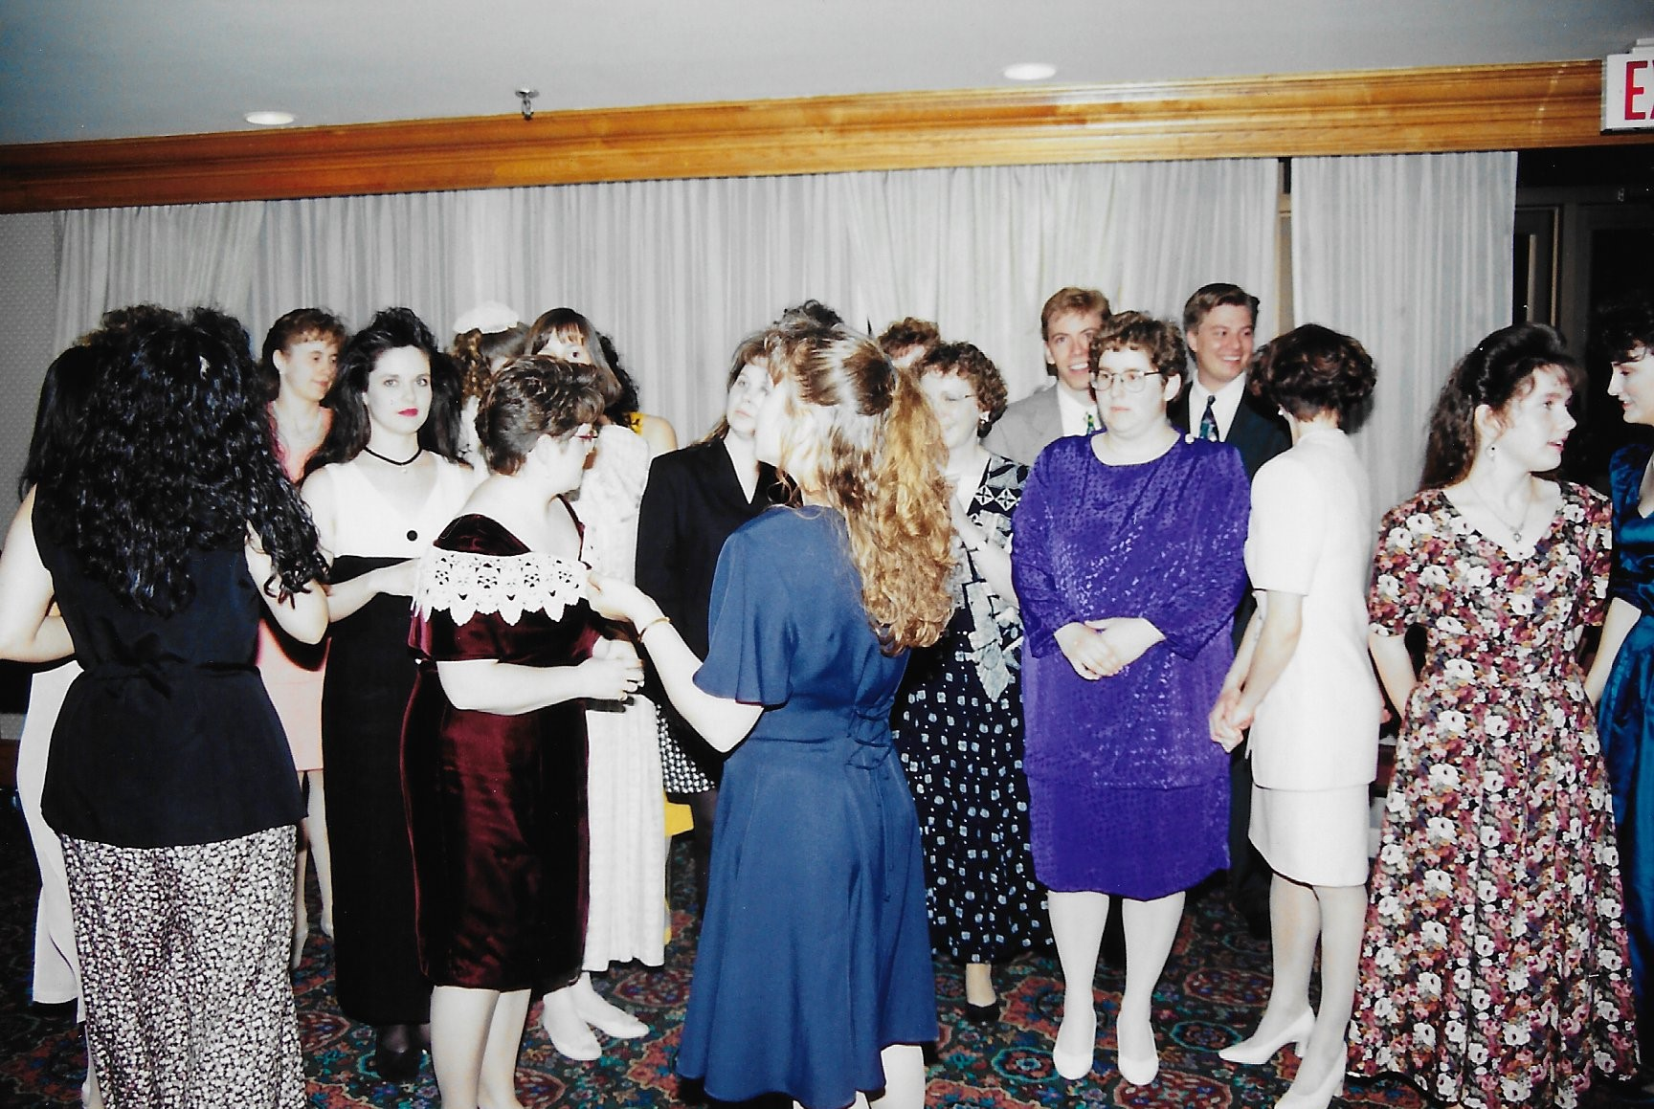
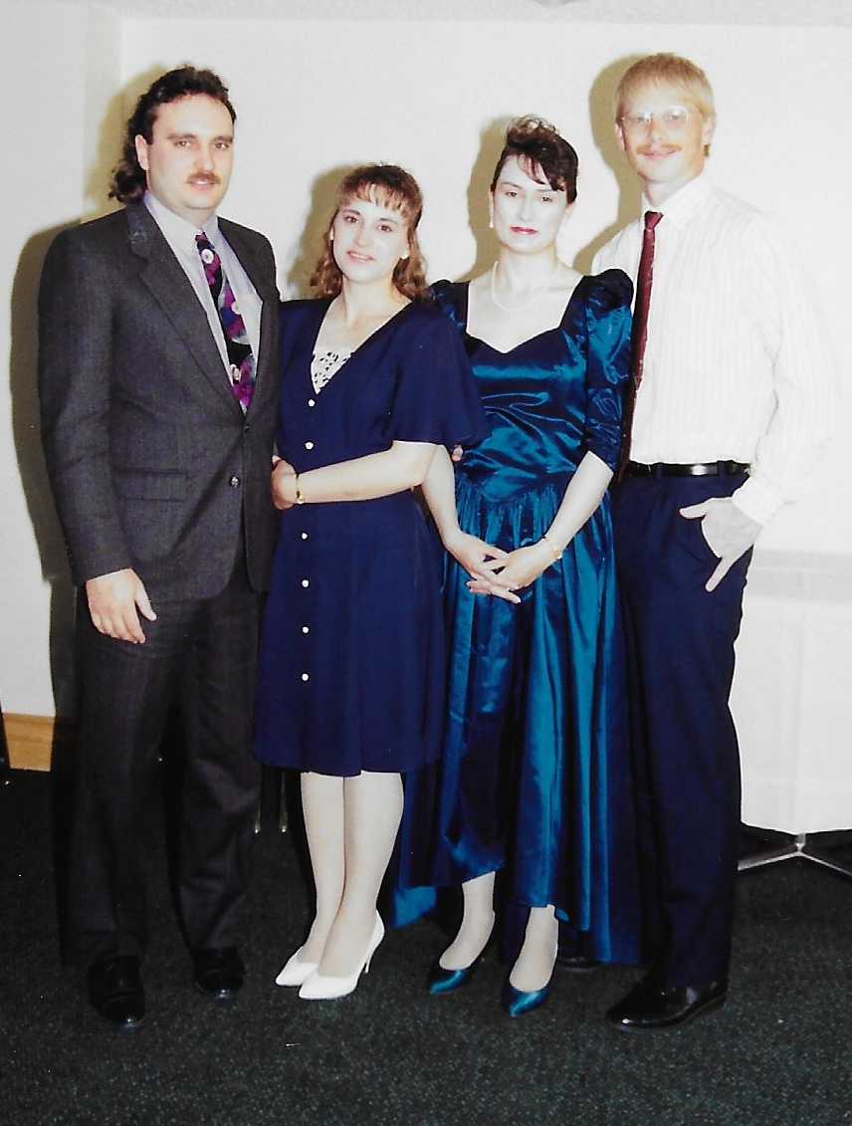
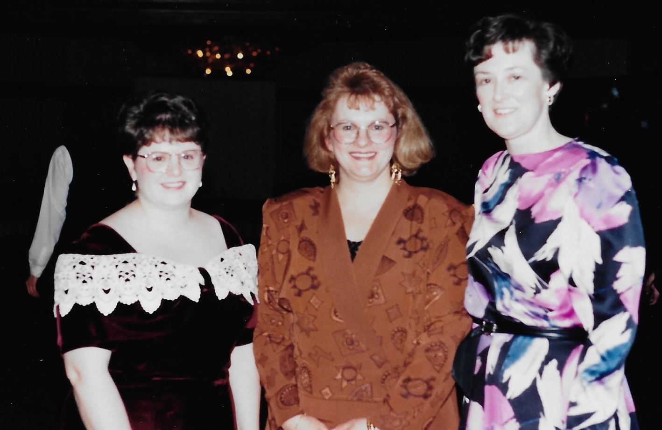
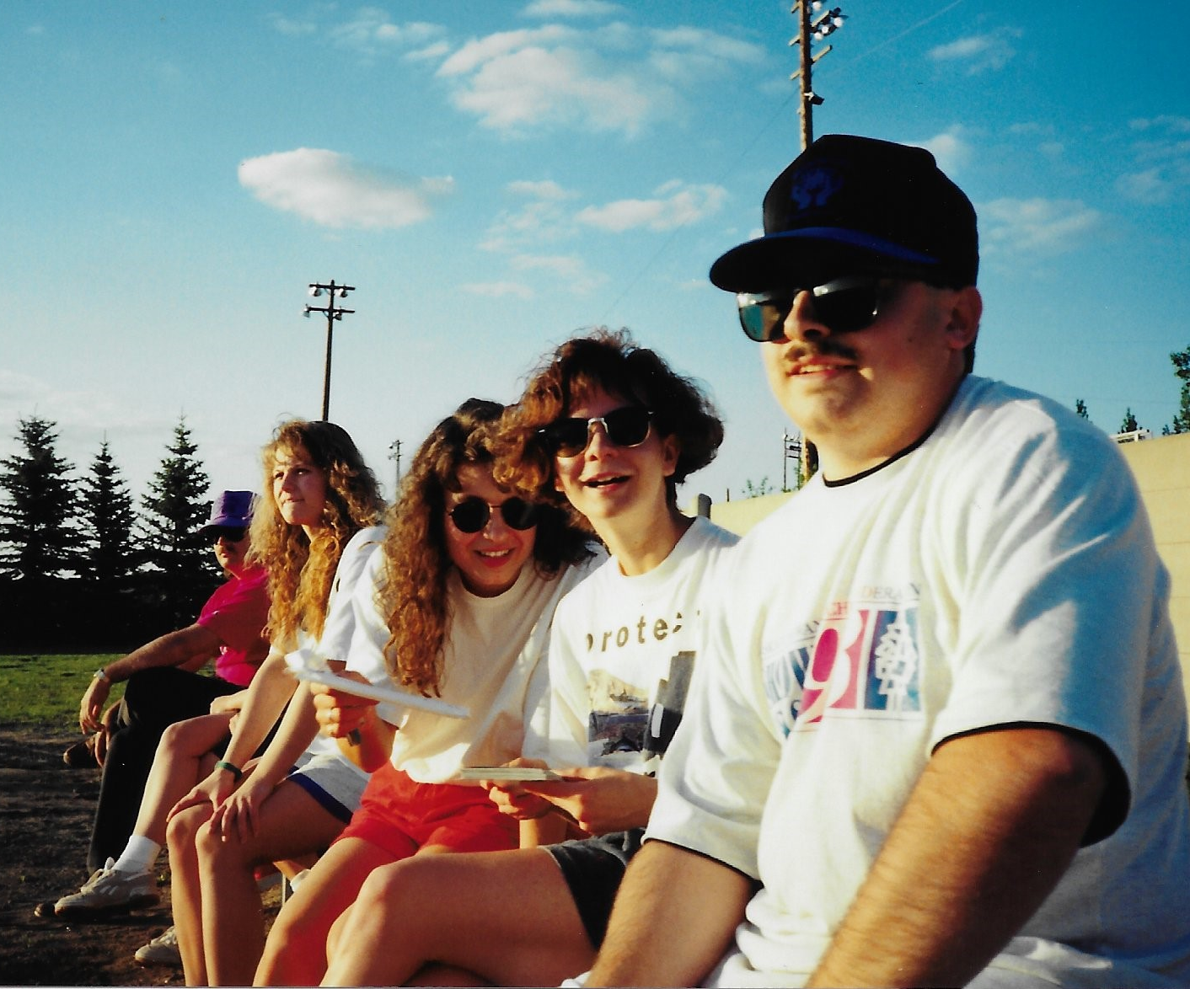

Slide 15
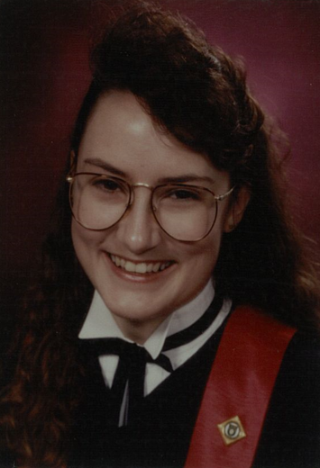
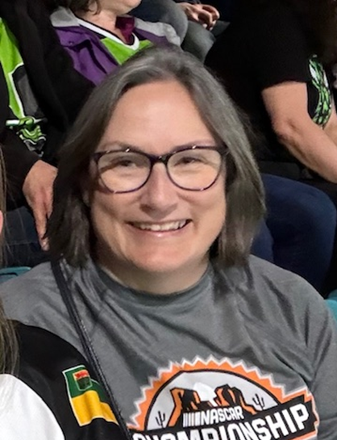
Rona Hadley Cole

Slide 16
Rona Hadley Cole
Lives in Lac La Ronge.
Works in La Ronge Public Health, as a Public Health Nurse and Lactation Consultant.
Have great opportunities to travel to more remote communities.
Enjoys meeting families and appreciates differences accessing healthcare.
Enjoys cruises, Disney, and taking in some sporting events.
Will be working to travel the next few years.
Enjoys my quiet cabin in Napatak, south of La Ronge.
Kenickie, small 17-year-old pup and new Joey, a Husky cross.
Favourite USask memory: All the times visiting between classes and clinical made a stressful time of life so much better!

Slide 17
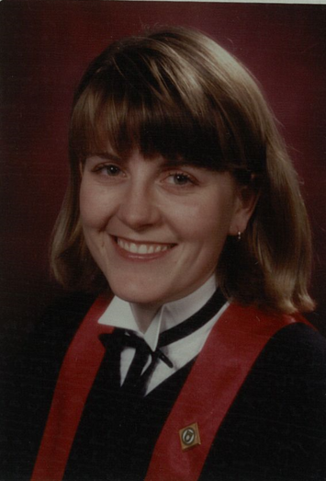
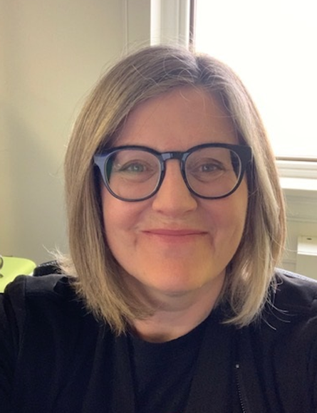
Leegay Jagoe

Slide 18
Leegay Jagoe
Lives in Saskatoon, SK.
Works as an Outreach Coordinator for Indigenous Services Canada, with a harm reduction and STBBI focus.
My career will take a shift, as taking my PhD in Nursing.
Plan to focus on research and teaching.
Our family of five:
Mia, 12-year-old daughter
Our children: Mickey the cat & Daisy and Twizzler the dogs.
We have plans to move out to the country next year.
Favourite USask memory: Learning and laughing with you good people.

Slide 19
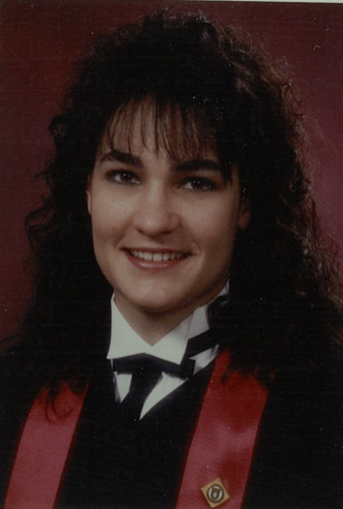
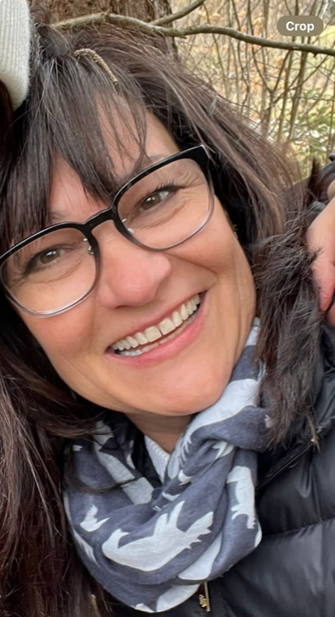
Eva Lehnert-Thiel (Boehmler)

Slide 20
Eva Lehnert-Thiel (Boehmler)
Lives in Saskatoon, SK.
Works on the medical day care unit at RUH.
Developed a new esophageal motility program, in the last year.
Revised all our clinical Investigation protocols and standards alongside our endocrinologists.
2024 had my right hip replaced, due to past injuries.
Maya moved out in February and convocating from Pharmacy in June.
She will be getting married in September.
Wedding planning is fun and much easier the second time around!
Claudia is expecting at the end of November, becoming a grandmother for the first time.

Slide 21
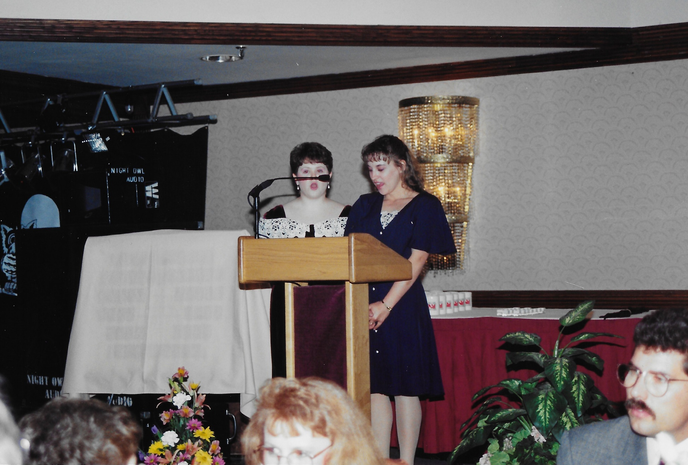
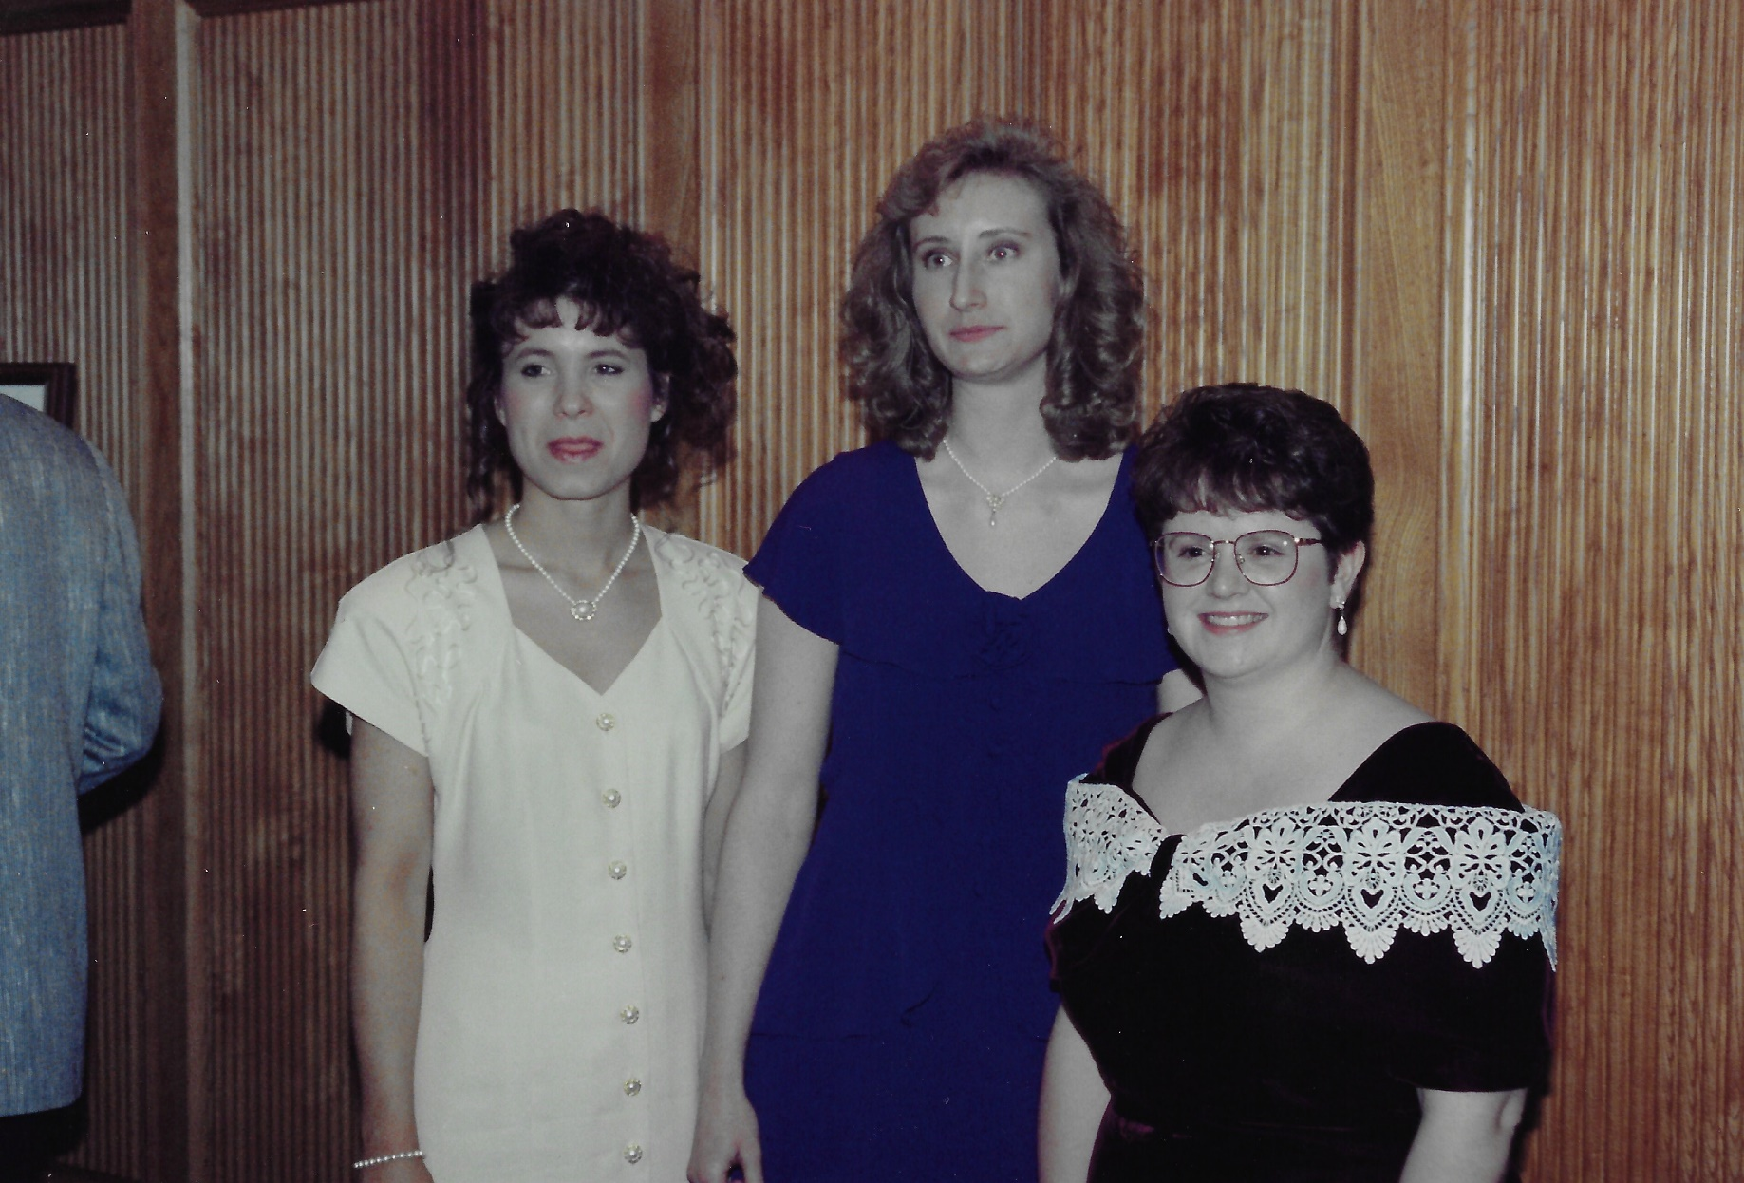
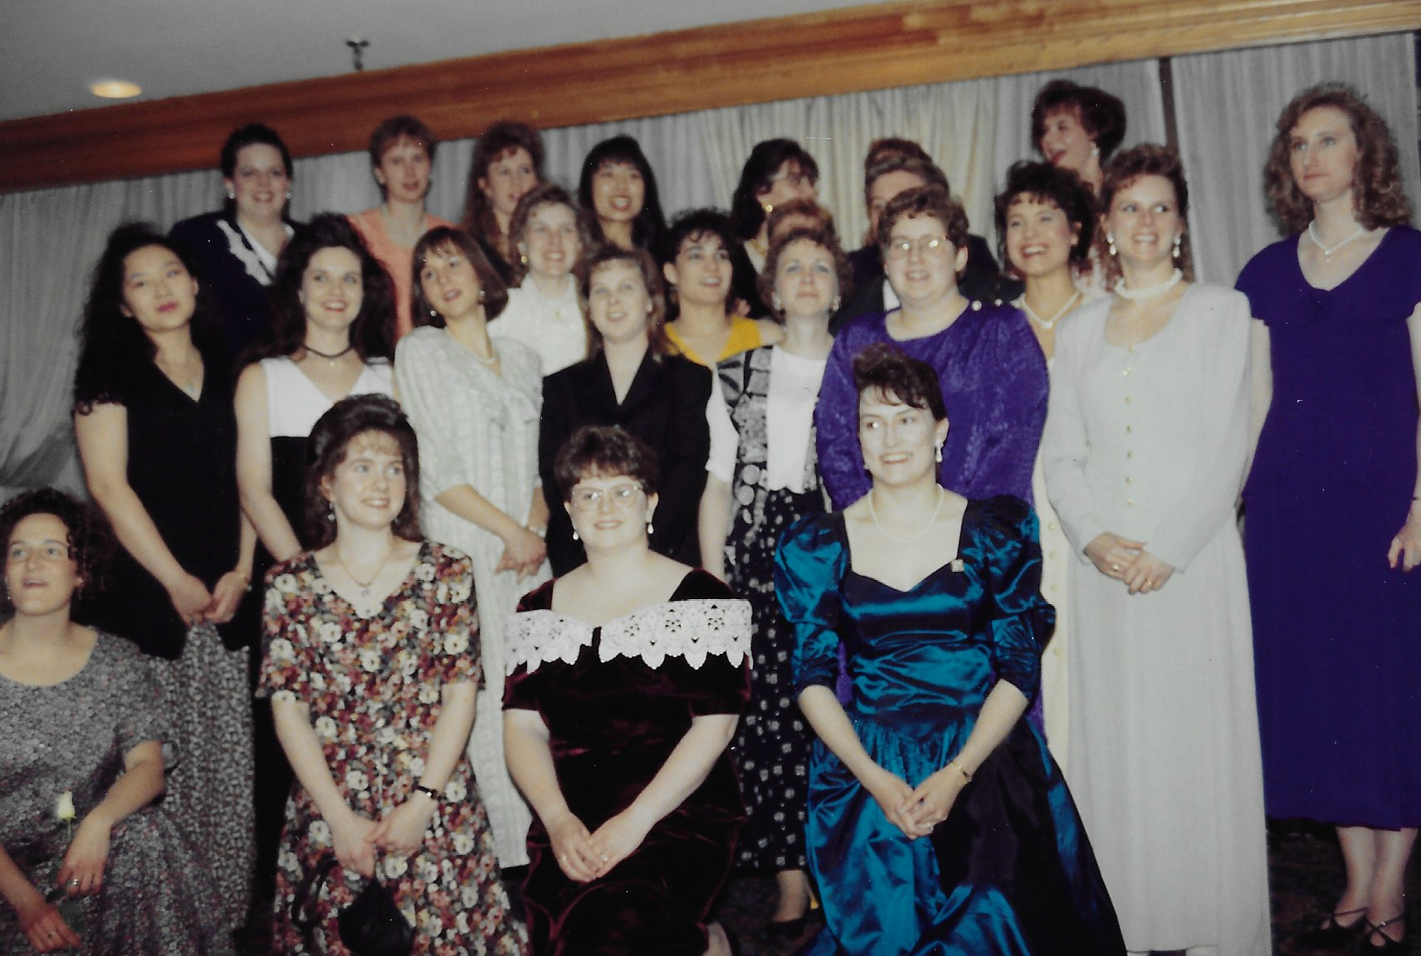
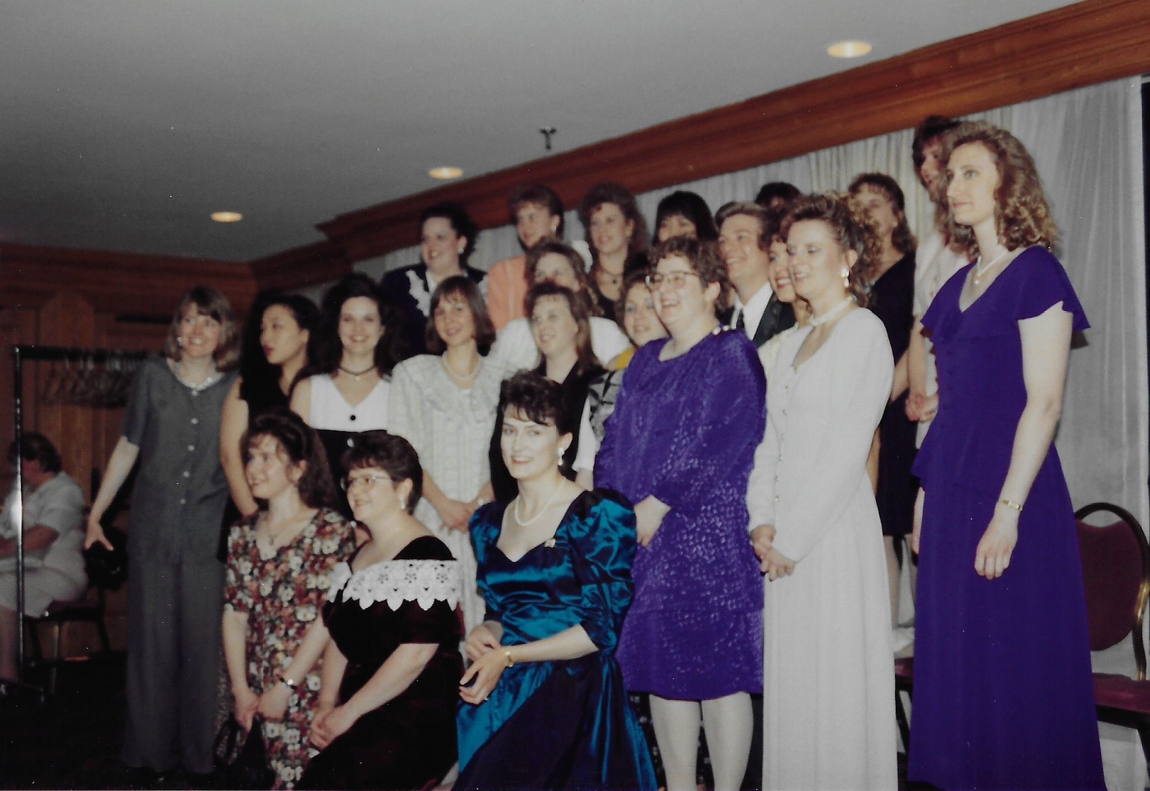

Slide 22
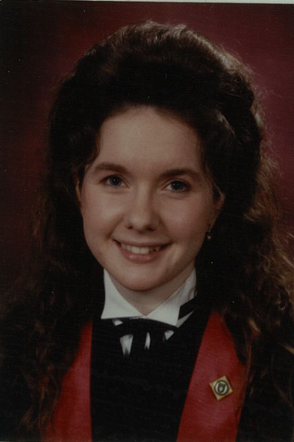
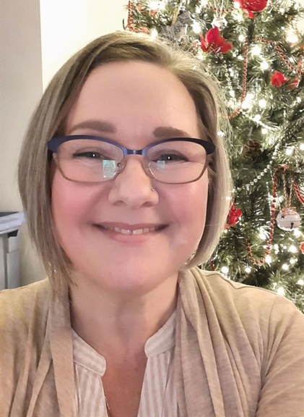
Anna-Lisa Morrison (Jansson)

Slide 23
Anna-Lisa Morrison (Jansson)
Lives in Maple Ridge, BC.
1994 Regina - Medical Adult and Pediatric ICU/CCU/PCCU (12 years)
2007 Moved to Cranbrook BC.
Medical & Pediatric ward (casual) at the East Kootenay Facility.
2010 - LPN Instructor: College of the Rockies in Fernie and Cranbrook.
2013 Moved to Vancouver.
Worked for NavCanada in pilot training school, then nursing instructor at CDI College.
Canada Life, Medical Coordinator (9 years).
Completed my Provincial Instructor Diploma 3 years ago.
Married to Elliot for almost 28 years.
4 children, Jenna (25), James (23), Garrett (20), Brynn (16).
Planning a trip down the east Coast in the US this fall.
Favorite USask Memory: I have fond memories of many of our instructors and those crazy early clinical days. I recall doing lab testing and having to examine those cute volunteers while blushing!

Slide 24
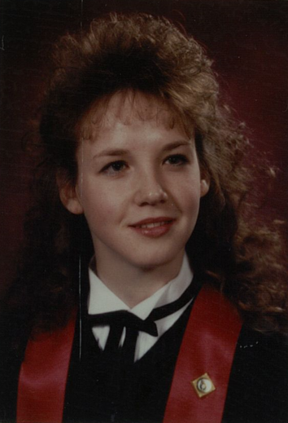
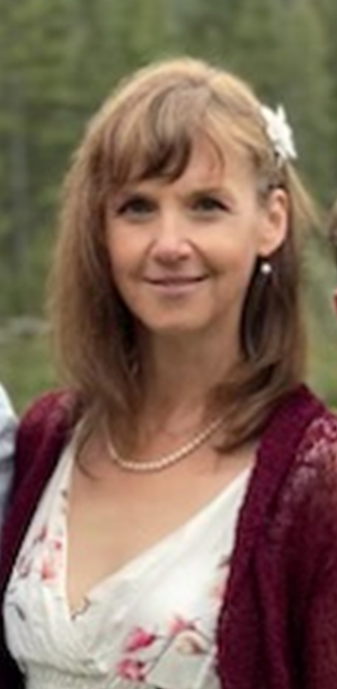
Tanja Puchala (Merrett)

Slide 25
Tanja Puchala (Merrett)
Lives in Ottawa, ON.
1994 worked as a Community Health Nurse with MSB, Health Canada.
For 6 months: worked as an IV therapist in Ottawa.
Back to SK as a Band Nurse for Mistawasis, Cree Nation.
1997 married Colin and moved to Edmonton.
Worked PICU at Stollery Hospital.
Travel Medicine trained and Internationally certified.
Worked last 20 years as a Travel Health Nurse Specialist in Edmonton and now in Ottawa.
2 daughters in University & son in Grade 10.
Enjoys family trips, board games, and outdoor activities.
Personal extra curricular is Community Theatre: act in many plays, backstage and have joined numerous play reading committees.
Favourite USask memory: Booster Dances and Syringe Shots. Mumps lounge to group study.

Slide 26
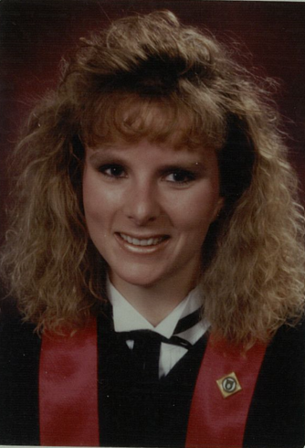
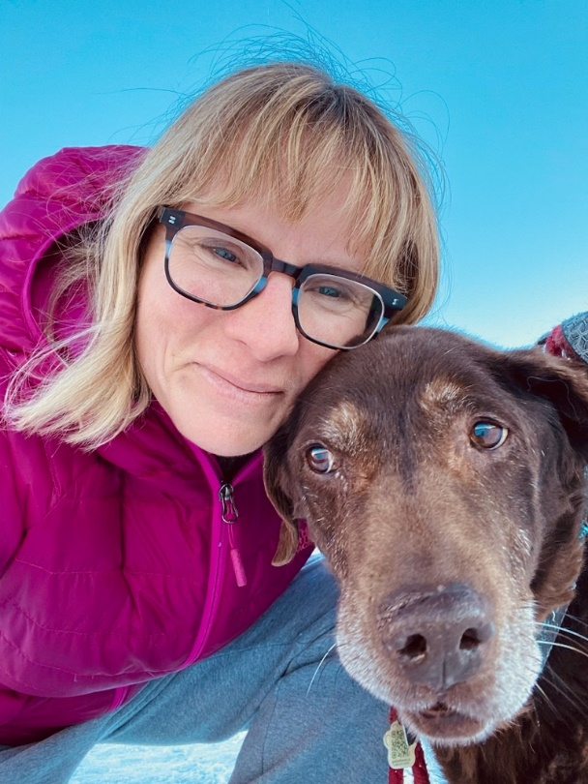
Tara Renkas

Slide 27
Tara Renkas
Lives in Calgary, AB.
Current-2018. Manager L& D, Postpartum, Antepartum, Foothills Medical Center, Calgary.
2011-2018: Clinical Nurse Educator for Labour and Delivery, FMC. Prior to CNE, RN on L&D, and Manager for Low Risk OB clinics. Worked in Chief Nursing Office for Alberta Health Services.
Prior to coming to Alberta, worked in in L&D, Regina General Hospital, as well as working in rural/urban Community Health. Worked in Baton Rouge for 1 year, labour and delivery.
Married 28 years this July, to Gerard.
Two children: Hannah (24) & Jonah (22).
Enjoys weightlifting, time with family & friends, camping, travelling, golfing, hiking, pickleball, gardening, and cooking.
Favourite USask memory: Pub crawls, eating lunch with everyone between classes, and meeting Gerard my last year. Laughing so hard you cry when we spent time together outside of class!

Slide 28
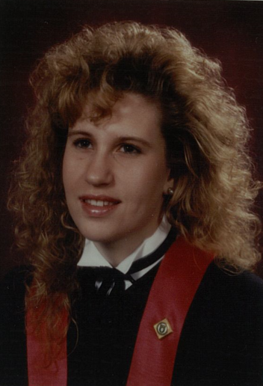
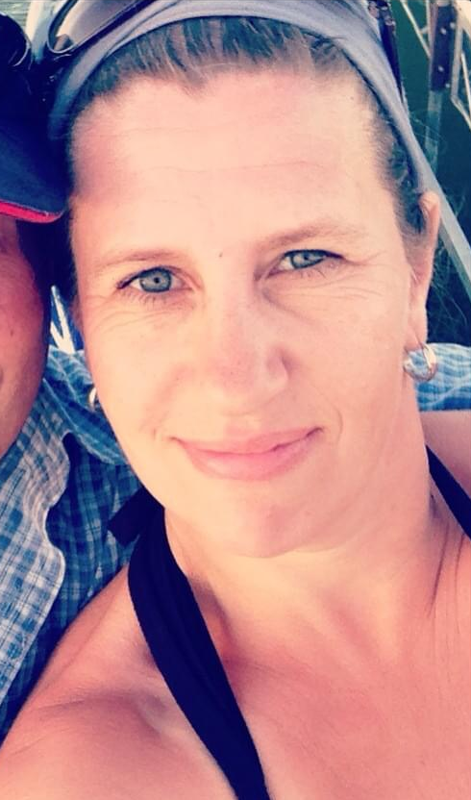
Tara Schlosser (McCulloch)

Slide 29
Tara Schlosser (McCulloch)
Lives in Dalmeny, SK.
Saskatchewan Bleeding Disorders Program as a Clinical Nurse Coordinator (13 years).
2019-2022 returned to PICU Temp and worked in both areas.
Nursing in PICU for 18 years.
Home care, LTC, ICU, PICU, USask Clinical Educator Instructor, Chronic Disease Management, research.
College of Nursing, one of the best decisions I have made.
Married 30 years this May to Trevor.
3 children (25), (23) and (21).
Building our forever home/cabin at the lake by Moose Jaw.
Love to travel in the cold winter months to somewhere warm.
Spend much of our time with family and friends.
Favourite USask memory: Loved that we had a small group and knew each other. Nursing pub crawls were always eventful and more fun for some.

Slide 30
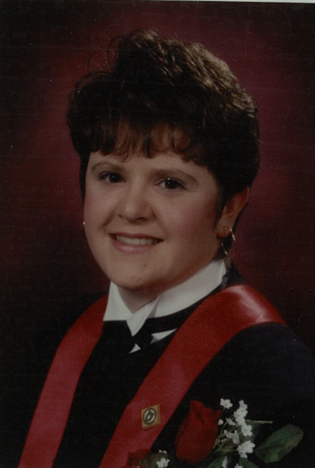
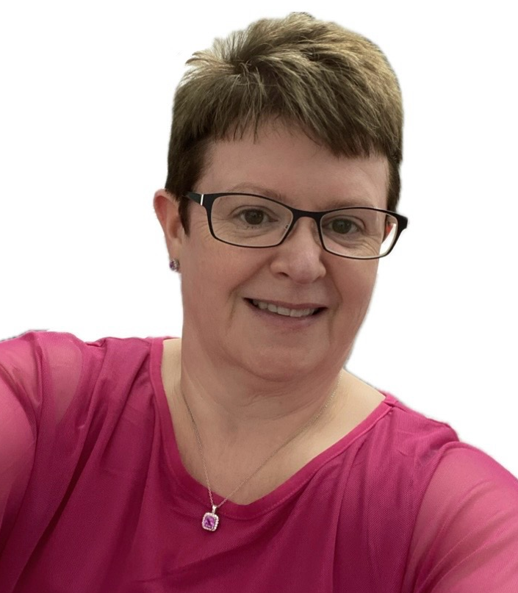
Janice Seebach (Eastley)

Slide 31
Janice Seebach (Eastley)
Lives in Saskatoon, SK.
1994 Population and Public Health - Saskatoon - South East Health Centre.
1997 Sexual Health Program & STI Clinic, Saskatoon, SK.
2004-2012 Owned a Tupperware Business.
2012 Returned to Sexual & Street Health as the Nurse Clinician.
September 2023 – currently the Provincial SHA STBBI Coordinator.
Married for 30 years to Collin.
Two children: Erica (28) & Evan (26).
Enjoys reading, painting, gardening, baking, watching reality TV, yoga and watching Collin curl.
We are enjoying our “empty nester” time!
Favourite USask memory: Dance therapy, semi-circle classroom with Cindy Peternelj-Taylor, lower Place Riel and the Arts Movie Theatre.

Slide 32
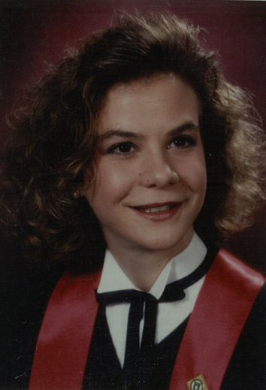
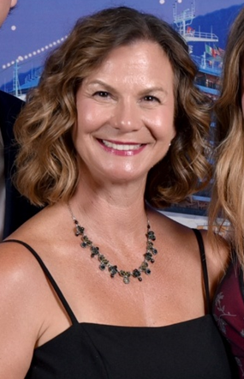
Paula Gurule (Sinclair)

Slide 33
Paula Gurule (Sinclair)
Lives in Pleasanton, California, USA.
1994 worked in Lubbock Texas, at the Methodist Children's Hospital ER.
1996 Travel Nursing in Pediatric ER's, PICU's and NICU’s (7 years).
Currently at John Muir Hospital NICU in Walnut Creek, CA (20-year pin in the Fall).
8-hour night shifts - spent mentoring new nurses, attending high risk deliveries and caring for sick/growing babies and families.
Married in 2000 to Jeff.
Two children: Jackson (20) & Alena (18).
Return to family cabin in Eston, SK every summer for 2-3 weeks.
Will travel & spend time on our boat in the San Francisco Bay.
Favorite USask memory: The "Nurses call the Shots" dance, where we were using syringes to deliver shots and storing the money we collected in the oven. Dissecting cadavers on campus and our nursing labs.

Slide 34
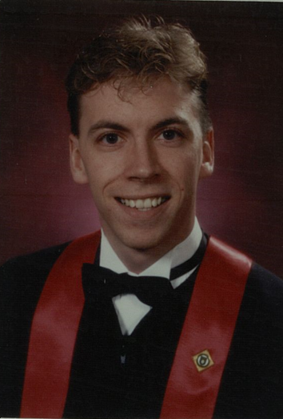
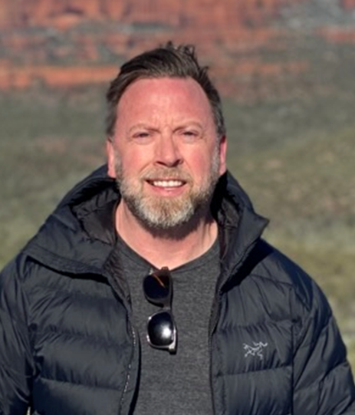
Claude Stang

Slide 35
Claude Stang
Lives in Los Angeles California, USA.
1994 Lubbock, Texas and worked med/surgery.
1995 Back to Saskatoon & worked in pediatrics and public health.
1996 US Travel Nurse, working in interesting locales in Arkansas, California, and Washington.
Returned to Saskatoon as I landed my dream job in the ED at RUH (4 years)
Clinical work and teaching: an educator role at Vancouver General ED, then manager, then a couple years as patient flow director in administration.
Masters' degree in leadership at Royal Roads.
Richmond Hospital as acute care director for a few years.
Palm Springs: Director of ED and trauma for a couple of years, continue to own a home there.
Work in LA as Executive Director of emergency services at Cedars Sinai Medical Center (7 years).
Fellowship in Health Management Studies - GE Health Management Academy in New York.
Traveled to the Middle East, Asia, Europe, and Japan, amongst others.
I hike, golf, weight train, and curl when I am home.
My Canadian roots are never lost on me.
I am a big Blue Jays fan and get many requests to teach the skills of curling in LA.

Slide 36
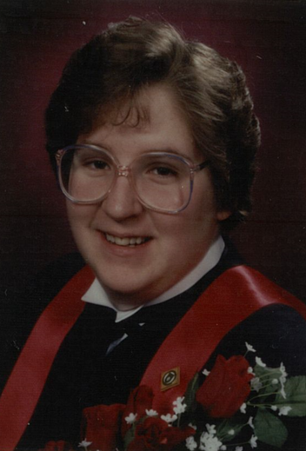
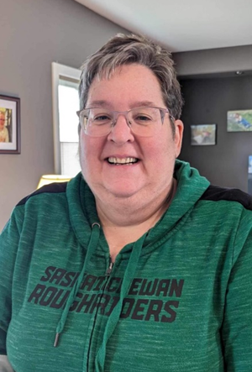
Kelly Greenwald (Tremaine/Taylor)

Slide 37
Kelly Greenwald (Tremaine/Taylor)
Lives in Battleford, SK.
Works in North Battleford as the communicable disease nursing supervisor: STBBI’s in the local former health region, integrated northern health and to the SHA provincially.
Married to Brian Greenwald (20 years).
Had a recent knee replacement.
3 children: Becky (31), Emma (28), Kyla (26)
Raising Adelyn, Kyla’s daughter (8 years).
Have Roughrider season tickets and enjoy our excursions to Regina.
Enjoys gardening.
Hopes to travel to Hawaii in the near future!
Favorite USask memories: Laughs and conversations between classes and in labs. I think fondly of all my university colleagues and quite enjoy when our paths cross and memories flash back!

Slide 38
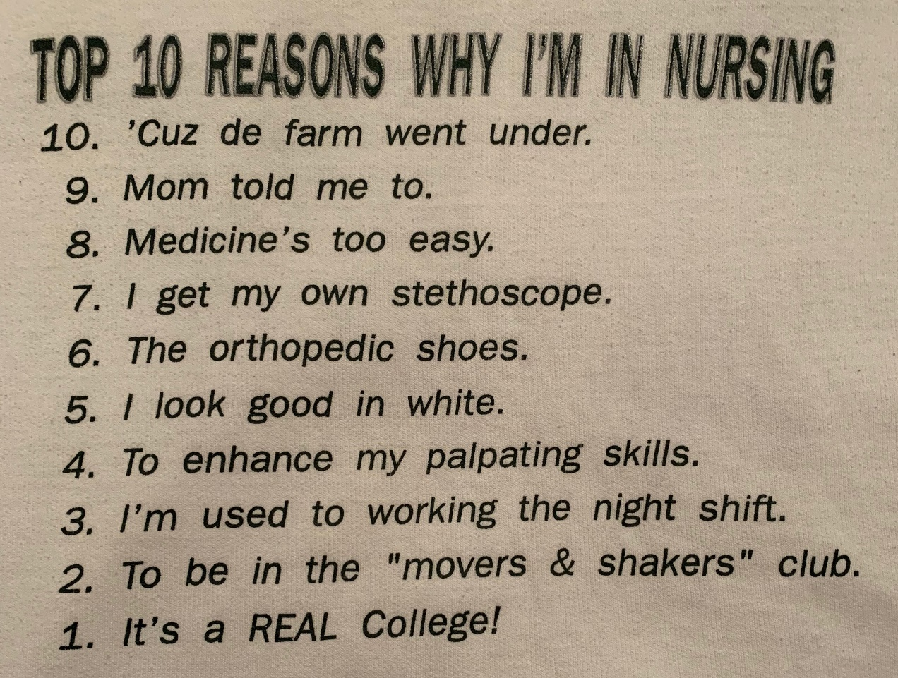

Slide 39
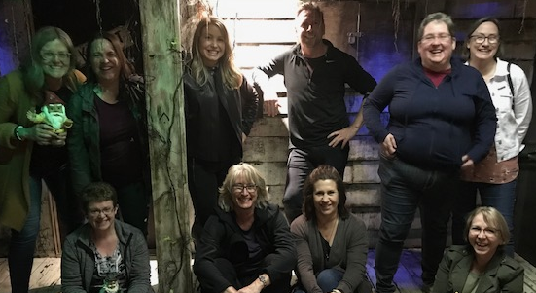
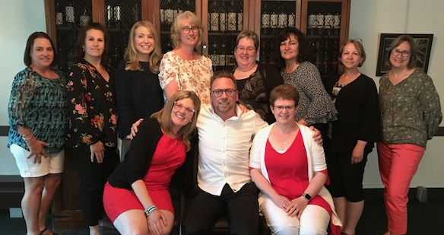
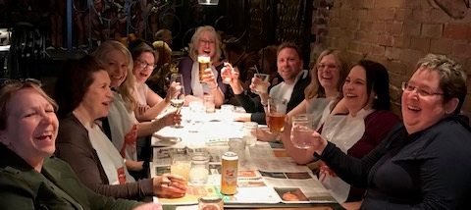

June 7-9, 2019

Slide 40





Slide 41








Slide 42





Slide 43





